Slide 1
Searching and Sorting
Chapter 18 of Visual C# How to Program, 6/e

Slide 2
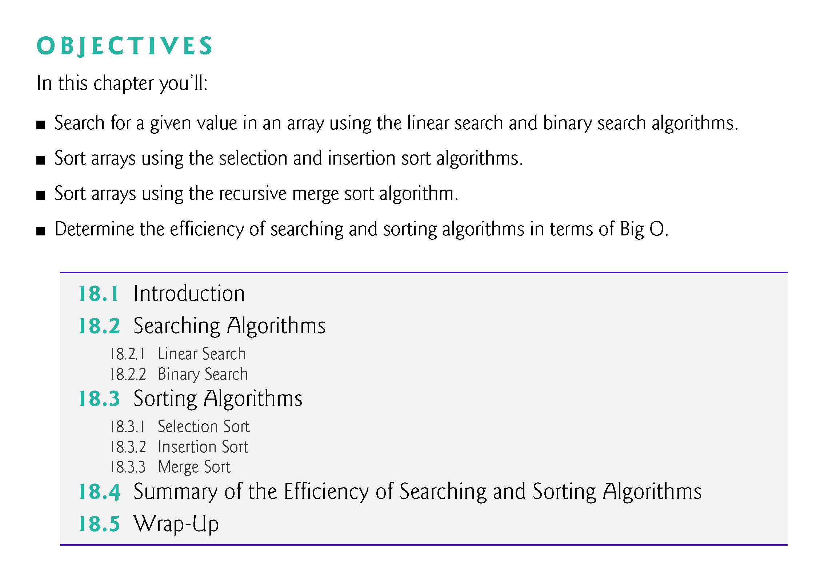

Slide 3
18.1 Introduction
Searching data involves determining whether a value (referred to as the search key) is present in the data and, if so, finding the value’s location.
Two popular search algorithms are the simple linear search and the faster, but more complex, binary search.
Sorting places data in order, based on one or more sort keys.
This chapter introduces two simple sorting algorithms, the selection sort and the insertion sort, along with the more efficient, but more complex, merge sort.
Figure 18.1 summarizes the searching and sorting algorithms discussed in this book.

Slide 4
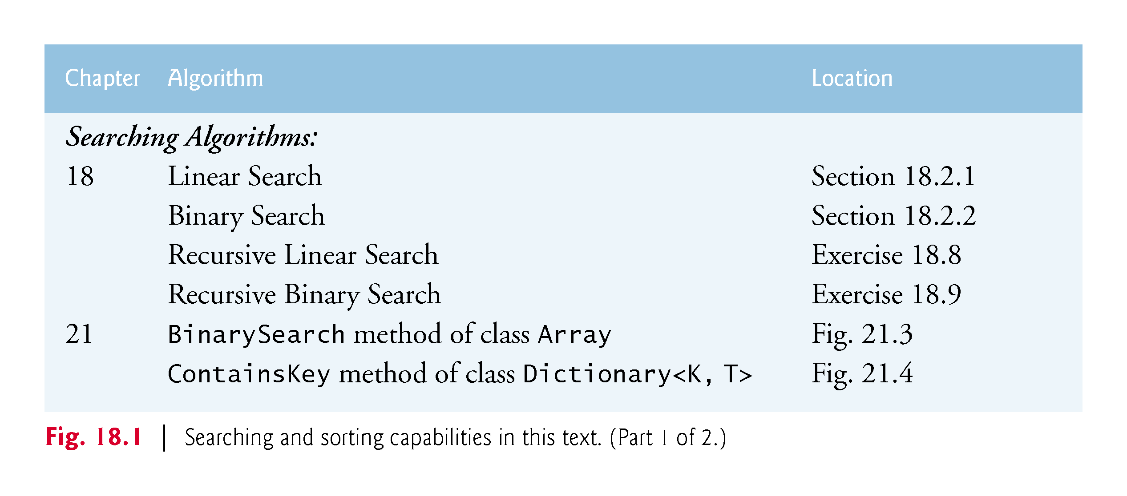

Slide 5
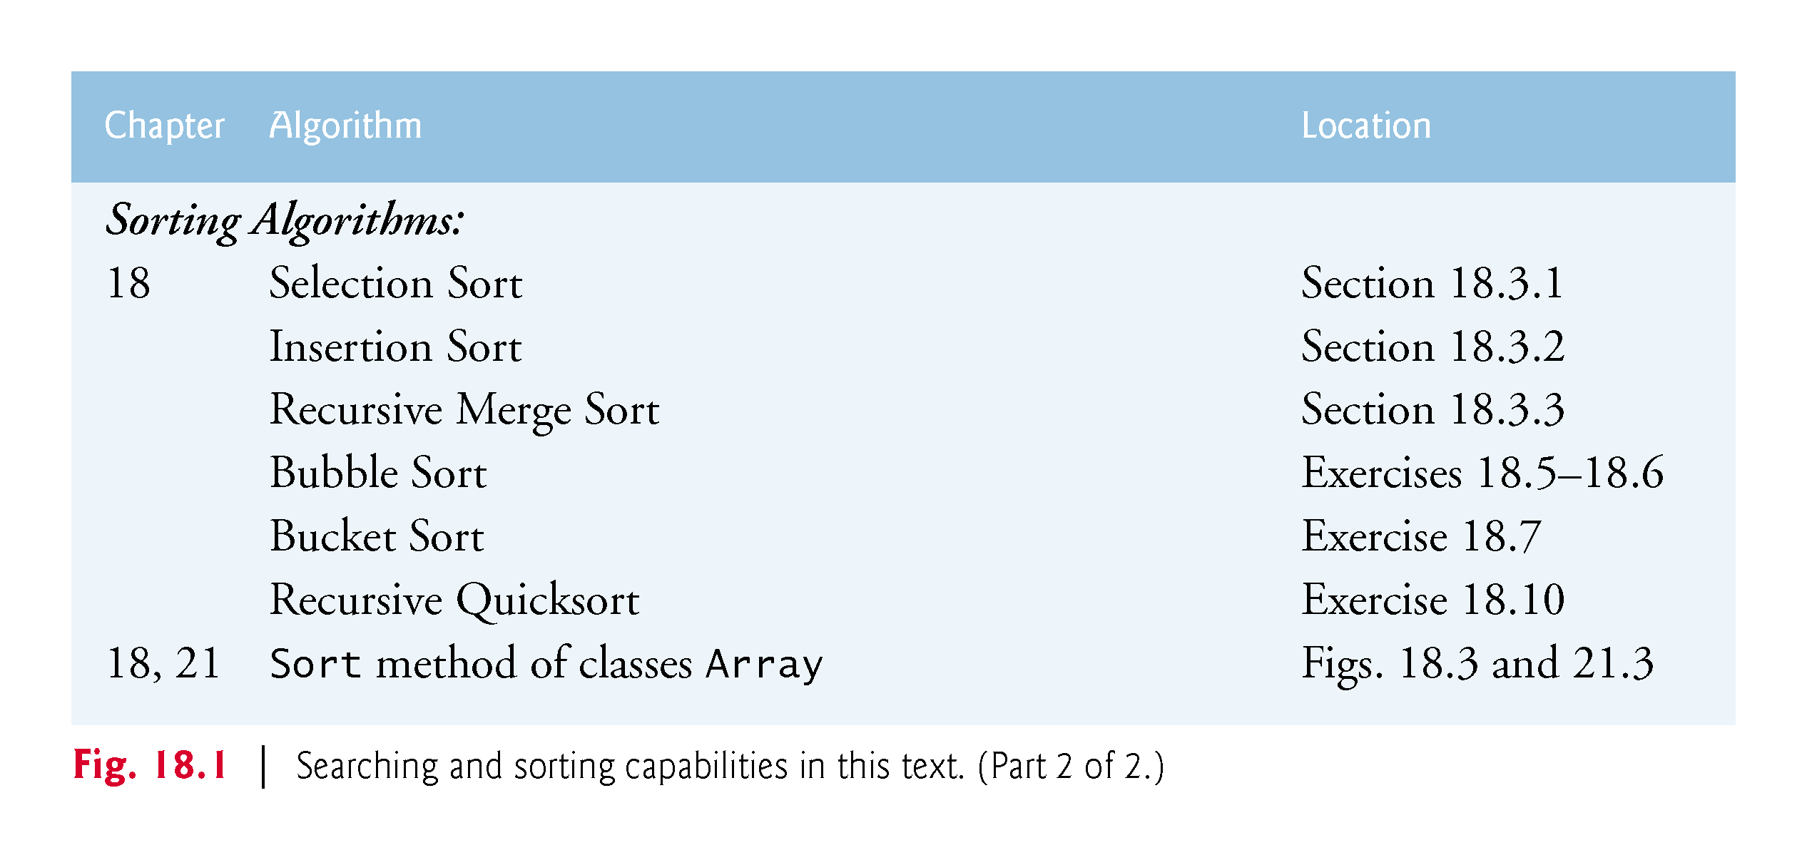

Slide 6
18.2 Searching Algorithms
The next two sections discuss two common search algorithms—one that is easy to program yet relatively inefficient and one that is relatively efficient but more complex to program.

Slide 7
18.2.1 Linear Search
The linear search algorithm searches each element in an array sequentially.
If the search key does not match an element in the array, the algorithm tests each element and, when the end of the array is reached, informs the user that the search key is not present.
If the search key is in the array, the algorithm tests each element until it finds one that matches the search key and returns the index of that element.

Slide 8
18.2.1 Linear Search (cont.)
As an example, consider an array containing the following values and a method that is searching for 51.
34 56 2 10 77 51 93 30 5 52
Using the linear search algorithm, the method first checks whether 34 matches the search key.
It does not, so the algorithm checks whether 56 matches the search key.
The method continues moving through the array sequentially, testing 2, then 10, then 77.

Slide 9
18.2.1 Linear Search (cont.)
When the method tests 51, which matches the search key, the method returns the index 5, which is the location of 51 in the array.
If, after checking every array element, the method determines that the search key does not match any element in the array, the method returns -1.
If there are duplicate values in the array, linear search returns the index of the first element in the array that matches the search key.

Slide 10
18.2.1 Linear Search (cont.)
Figure 18.2 declares class LinearSearchTest.
Main uses an int array data and a Random object named generator to fill the array with randomly generated ints in the range 10–99.

Slide 11
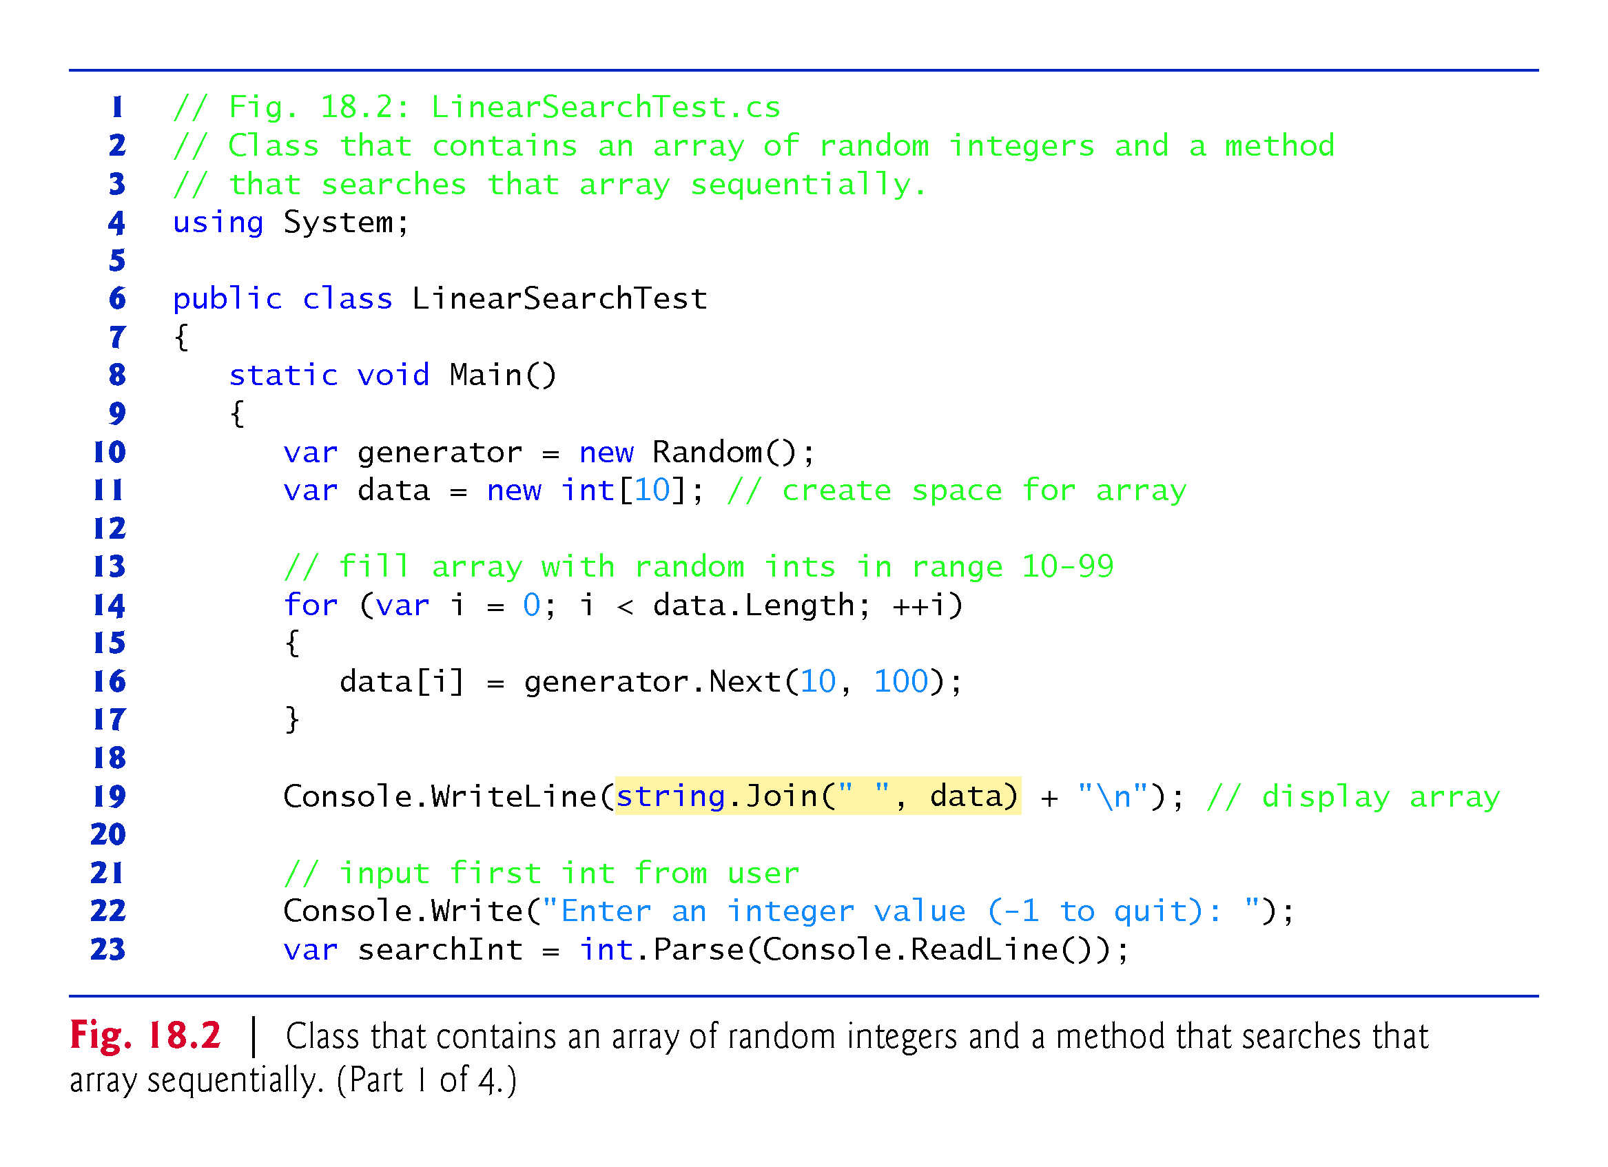

Slide 12
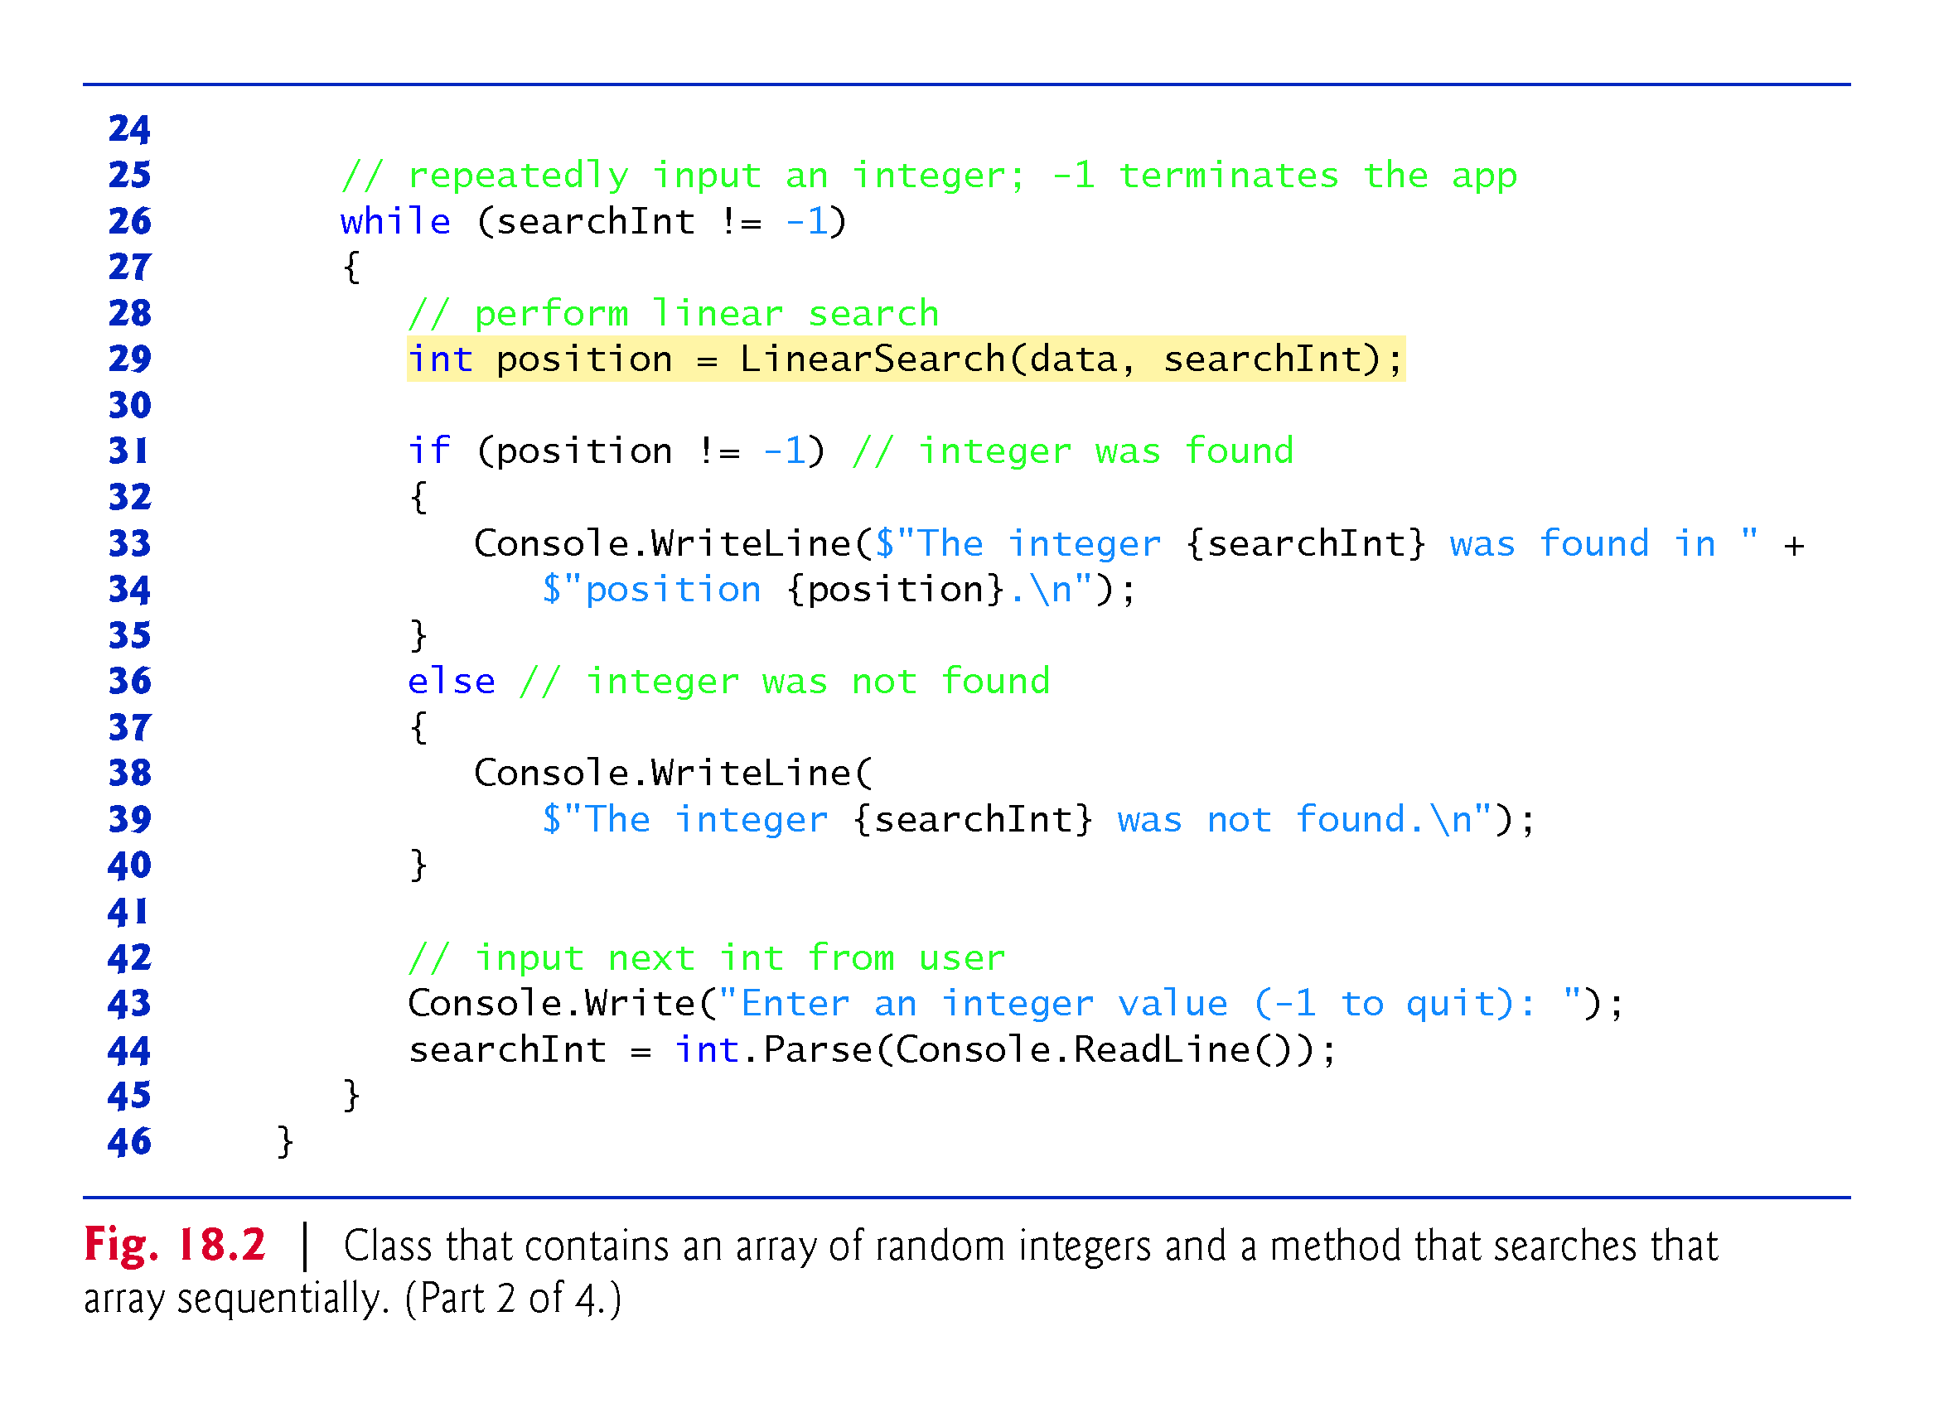

Slide 13
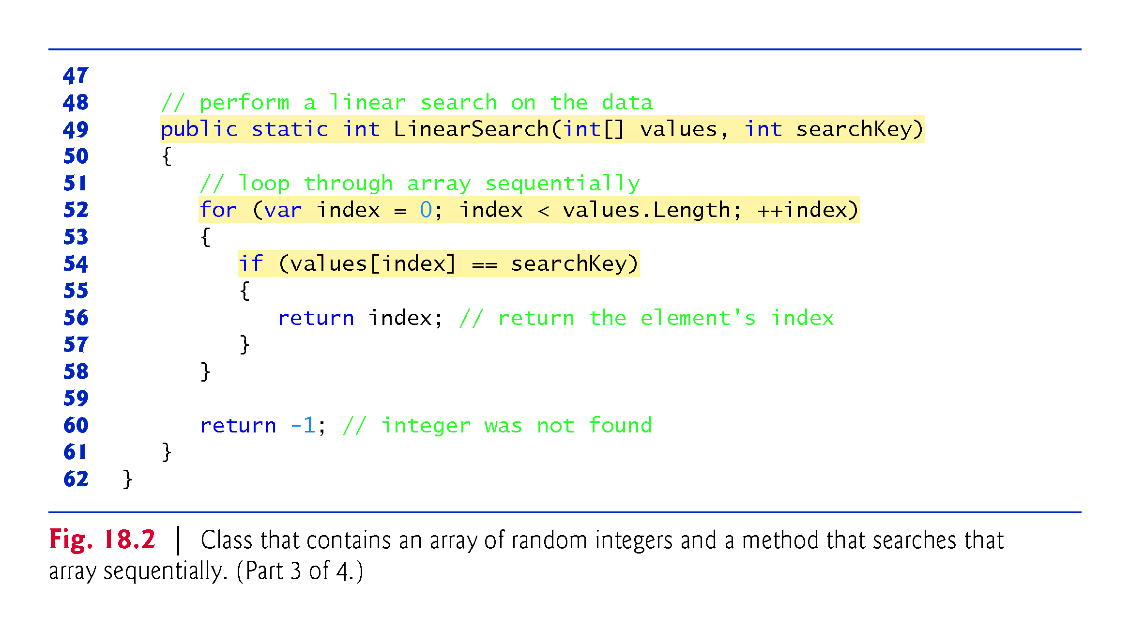

Slide 14
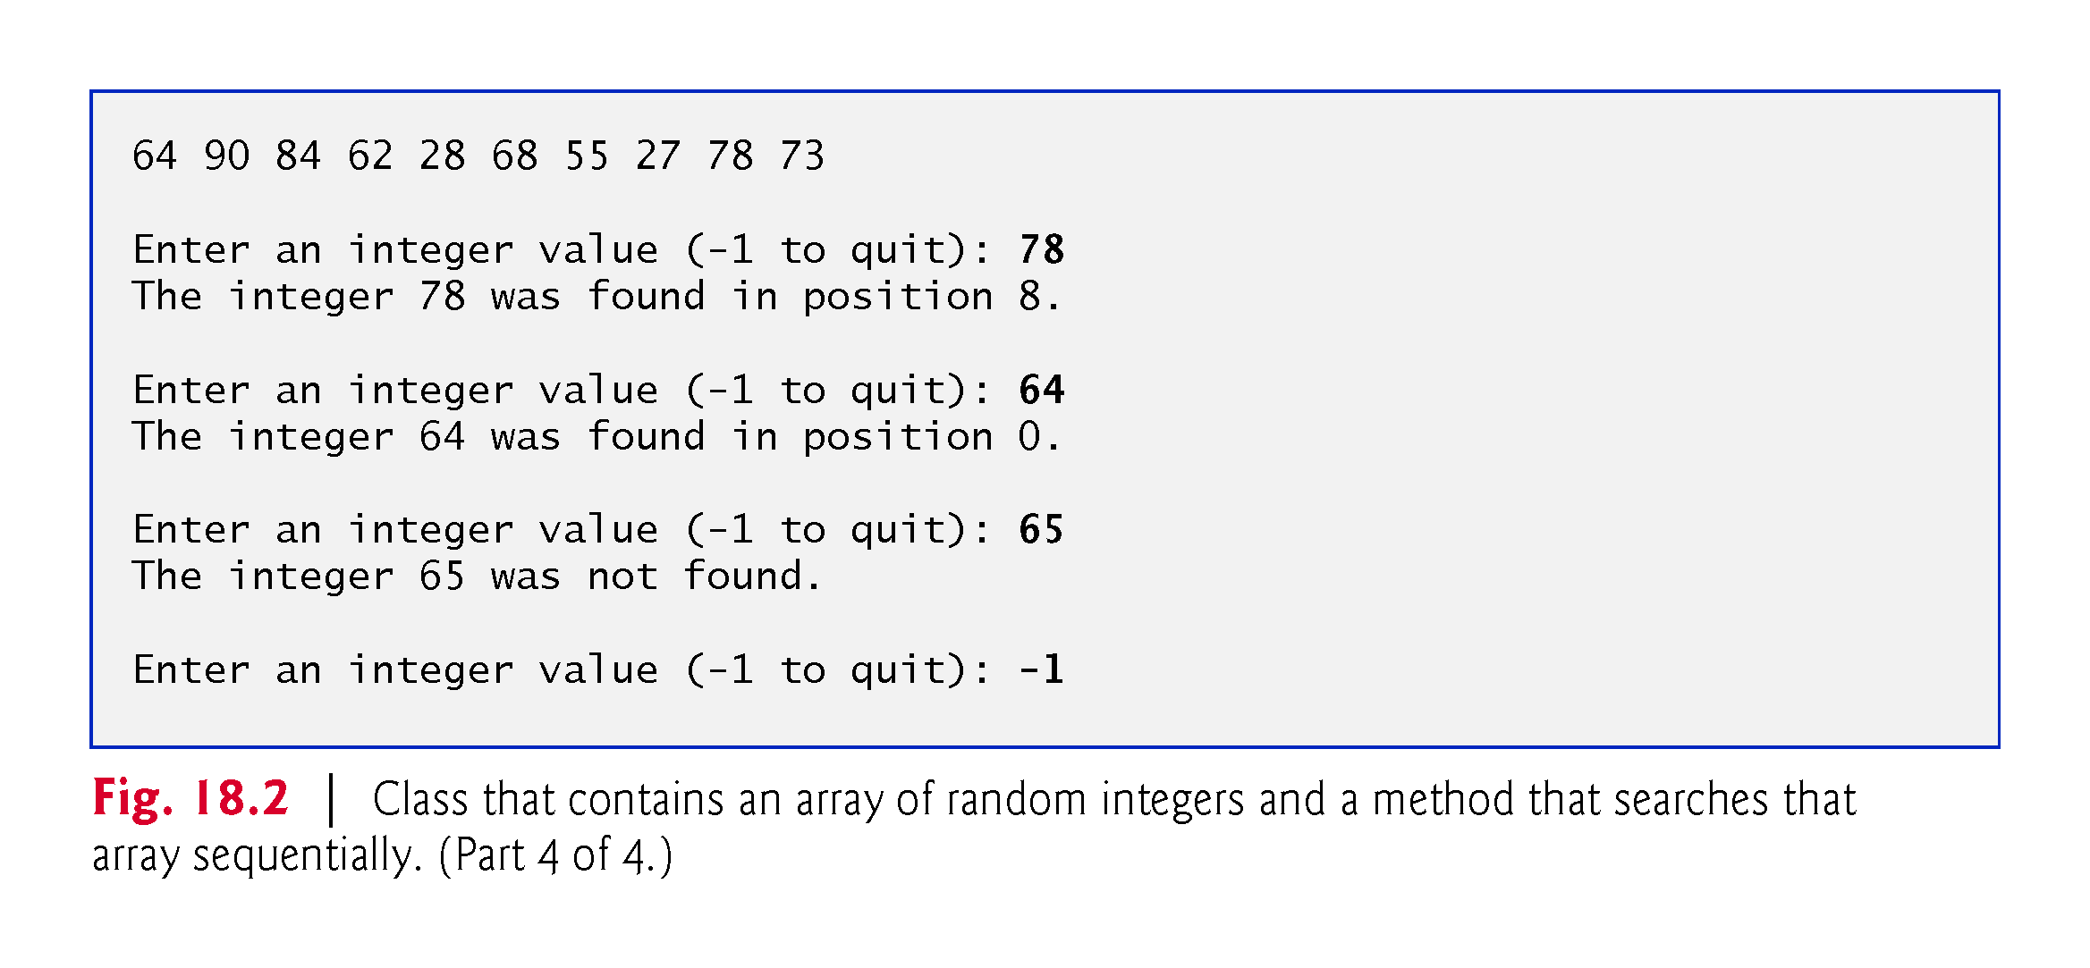

Slide 15
18.2.1 Linear Search (cont.)
Efficiency of Linear Search
Searching algorithms all accomplish the same goal—finding an element that matches a given search key, if such an element exists.
Many things, however, differentiate search algorithms from one another.
The major difference is the amount of effort required to complete the search.

Slide 16
18.2.1 Linear Search (cont.)
One way to describe this effort is with Big O notation, which is a measure of the worst-case runtime for an algorithm—that is, how hard an algorithm may have to work to solve a problem.
For searching and sorting algorithms, this is particularly dependent on how many elements there are in the data set and the algorithm used.
!!!

Slide 17
18.2.1 Linear Search (cont.)
Constant Runtime
Suppose an algorithm is designed to test whether the first element of an array is equal to the second element.
If the array has 10 elements, this algorithm requires one comparison.
If the array has 1,000 elements, this algorithm still requires one comparison. In fact, this algorithm is completely independent of the number of elements in the array, and is thus said to have a constant runtime, which is represented in Big O notation as O(1).
!!!

Slide 18
18.2.1 Linear Search (cont.)
An algorithm that is O(1) does not necessarily require only one comparison.
O(1) just means that the number of comparisons is constant—it does not grow as the size of the array increases.
An algorithm that tests whether the first element of an array is equal to any of the next three elements is still O(1), even though it requires three comparisons.
!!!
!!!

Slide 19
18.2.1 Linear Search (cont.)
Linear Runtime
An algorithm that tests whether the first element of an array is equal to any of the other elements of the array will require at most n – 1 comparisons, where n is the number of elements in the array.
If the array has 10 elements, this algorithm requires up to nine comparisons.
If the array has 1,000 elements, this algorithm requires up to 999 comparisons.
As n grows larger, the n part of the expression dominates, and subtracting one becomes inconsequential.
!!!
Notes:
Inconsequential 无关紧要的
Wúguān jǐnyào de

Slide 20
18.2.1 Linear Search (cont.)
Big O is designed to highlight these dominant terms and ignore terms that become unimportant as n grows.
For this reason, an algorithm that requires a total of n – 1 comparisons (such as the one we described earlier) is said to be O(n). An O(n) algorithm is referred to as having a linear runtime.
O(n) is often pronounced “on the order of n” or more simply “order n.”

Slide 21
18.2.1 Linear Search (cont.) p
Quadratic Runtime
Now suppose you have an algorithm that tests whether any element of an array is duplicated elsewhere in the array.
The first element must be compared with every other element in the array.
The second element must be compared with every other element except the first (it was already compared to the first).
The third element must be compared with every other element except the first two.
!!!
Notes:
Quadratic kwäˈdradik 二次方 Èr cì fāng

Slide 22
18.2.1 Linear Search (cont.)
In the end, this algorithm will end up making (n – 1) + (n – 2) + … + 2 + 1 or n2/2 – n/2 comparisons. （n² /2 – n/2）
As n increases, the n² term dominates and the n term becomes inconsequential. Again, Big O notation highlights the n² term, leaving n²/2.
But as we’ll soon see, constant factors are omitted in Big O notation.
Notes:
Inconsequential
无关紧要的
Wúguān jǐnyào de

Slide 23
18.2.1 Linear Search (cont.)
Big O is concerned with how an algorithm’s runtime grows in relation to the number of items processed.
Suppose an algorithm requires n² comparisons.
With four elements, the algorithm will require 16 comparisons; with eight elements, the algorithm will require 64 comparisons.
With this algorithm, doubling the number of elements quadruples the number of comparisons.
Consider a similar algorithm requiring n²/2 comparisons.
With four elements, the algorithm will require eight comparisons; with eight elements, 32 comparisons.

Slide 24
18.2.1 Linear Search (cont.)
Again, doubling the number of elements quadruples the number of comparisons.
Both of these algorithms grow as the square of n, so Big O ignores the constant, and both algorithms are considered to be O(n²), referred to as quadratic runtime and pronounced “on the order of n-squared” or more simply “order n-squared.”
When n is small, O(n²) algorithms (running on today’s billions-of-operations-per-second personal computers) will not noticeably affect performance.
But as n grows, you’ll start to notice the performance degradation.

Slide 25
18.2.1 Linear Search (cont.)
An O(n²) algorithm running on a million-element array would require a trillion “operations” (where each could actually require several machine instructions to execute).
This could require many minutes to execute.
A billion-element array would require a quintillion operations, a number so large that the algorithm could take decades!
O(n²) algorithms are easy to write, as you’ll see shortly.
You’ll also see algorithms with more favorable Big O measures.
These efficient algorithms often take more cleverness and effort to create, but their superior performance can be well worth the extra effort, especially as n gets large.

Slide 26
18.2.1 Linear Search (cont.)
Linear Search Runtime
The linear search algorithm runs in O(n) time.
The worst case in this algorithm is that every element must be checked to determine whether the search item exists in the array.
If the size of the array is doubled, the number of comparisons that the algorithm must perform is also doubled.
Linear search can provide outstanding performance if the element matching the search key happens to be at or near the front of the array.
But we seek algorithms that perform well, on average, across all searches, including those where the element matching the search key is near the end of the array.

Slide 27
18.2.1 Linear Search (cont.)
Linear search is the easiest search algorithm to program, but it can be slow compared to other search algorithms.
If an app needs to perform many searches on large arrays, it may be better to implement a different, more efficient algorithm, such as the binary search, which we present in the next section.

Slide 28
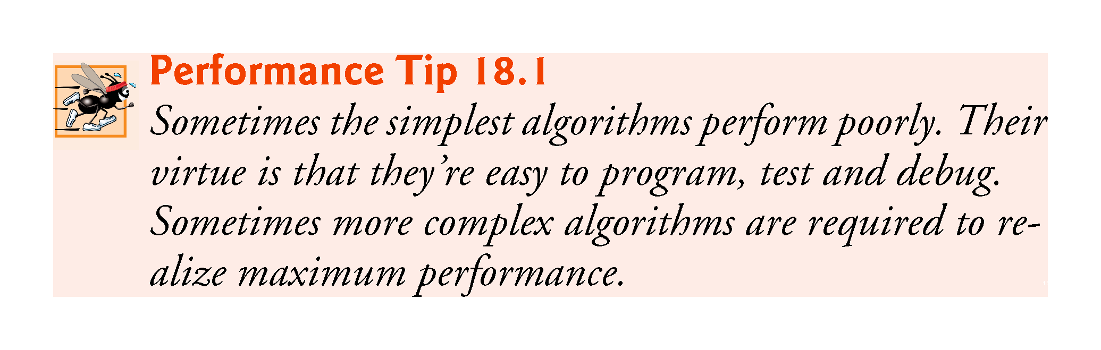

Slide 29
18.2.2 Binary Search p
The binary search algorithm is more efficient than the linear search algorithm, but it requires that the array first be sorted.
The first iteration of this algorithm tests the middle element in the array.
If this matches the search key, the algorithm ends.
Assuming the array is sorted in ascending order, if the search key is less than the middle element, the search key cannot match any element in the second half of the array and the algorithm continues with only the first half of the array (i.e., the first element up to, but not including, the middle element).
!!!

Slide 30
18.2.2 Binary Search (cont.)
If the search key is greater than the middle element, the search key cannot match any element in the first half of the array, and the algorithm continues with only the second half of the array (i.e., the element after the middle element through the last element).
Each iteration tests the middle value of the remaining portion of the array, called a subarray.
A subarray can have no elements, or it can encompass the entire array?.
If the search key does not match the element, the algorithm eliminates half of the remaining elements.
The algorithm ends by either finding an element that matches the search key or reducing the subarray to zero size.
Notes:
Encompass inˈkəmpəs 包括 Bāokuò

Slide 31
18.2.2 Binary Search (cont.)
As an example, consider the sorted 15-element array
2 3 5 10 27 30 34 51 56 65 77 81 82 93 99
and a search key of 65.
An app implementing the binary search algorithm would first check whether 51 is the search key (because 51 is the middle element of the array).
The search key (65) is larger than 51, so 51 is “discarded” (i.e., eliminated from consideration) along with the first half of the array (all elements smaller than 51.)
Next, the algorithm checks whether 81 (the middle element of the remainder of the array) matches the search key.

Slide 32
18.2.2 Binary Search (cont.)
The search key (65) is smaller than 81, so 81 is discarded along with the elements larger than 81.
After just two tests, the algorithm has narrowed the number of values to check to three (56, 65 and 77).
The algorithm then checks 65 (which indeed matches the search key) and returns the index of the array element containing 65.
This algorithm required just three comparisons to determine whether the search key matched an element of the array.
Using a linear search algorithm would have required 10 comparisons.

Slide 33
18.2.2 Binary Search (cont.)
In this example, we have chosen to use an array with 15 elements so that there will always be an obvious middle element in the array.
With an even number of elements, the middle of the array lies between two elements.
We implement the algorithm to choose the higher of the two elements.
Figure 18.3 declares class BinarySearchTest to implement and test a binary search.
Method Sort is a static method of class Array that sorts the elements in an array in ascending order.
Recall that the binary search algorithm works only on sorted arrays.

Slide 34
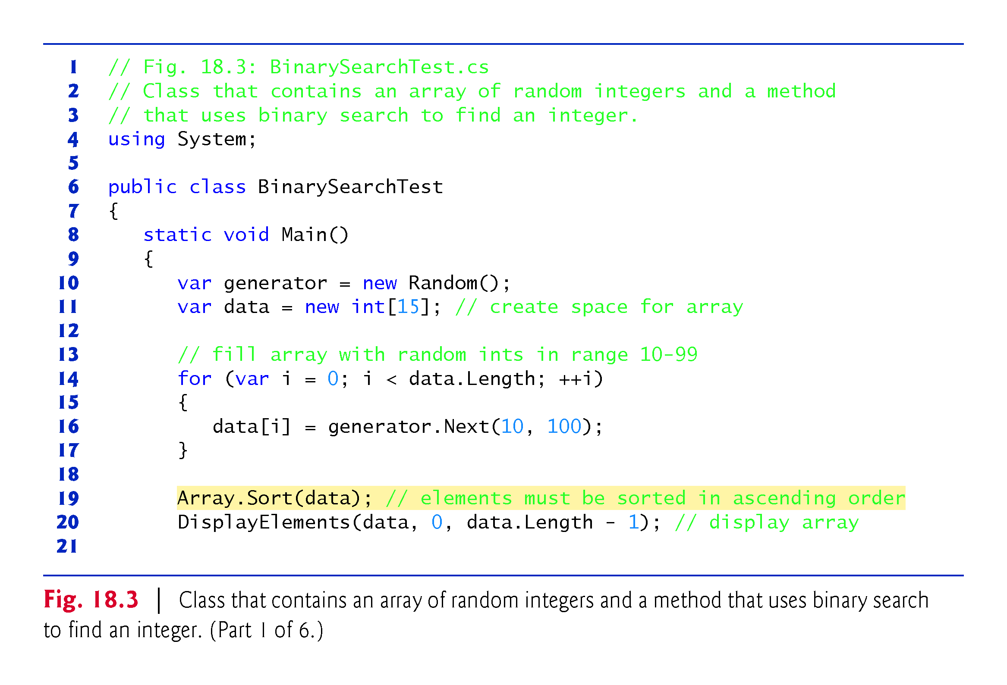

Slide 35
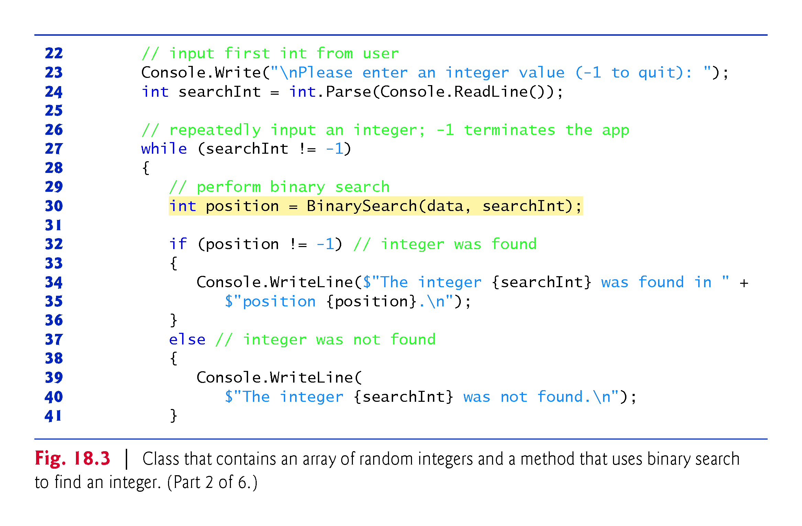

Slide 36
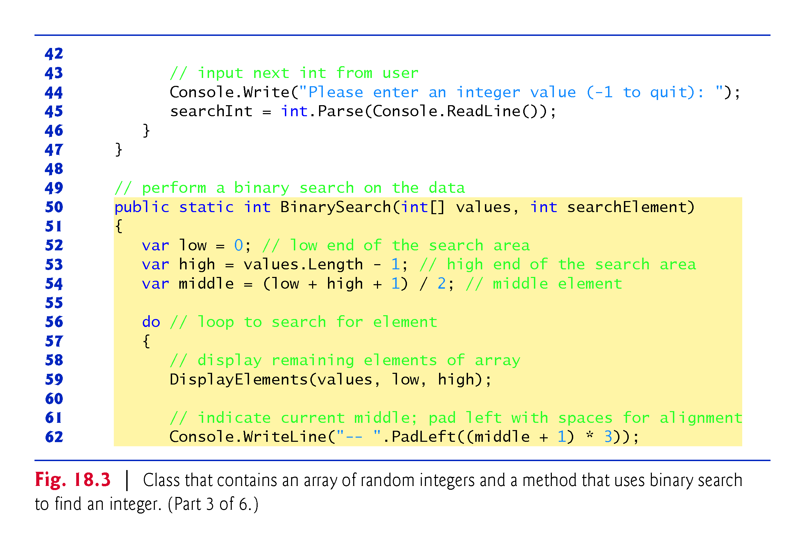

Slide 37
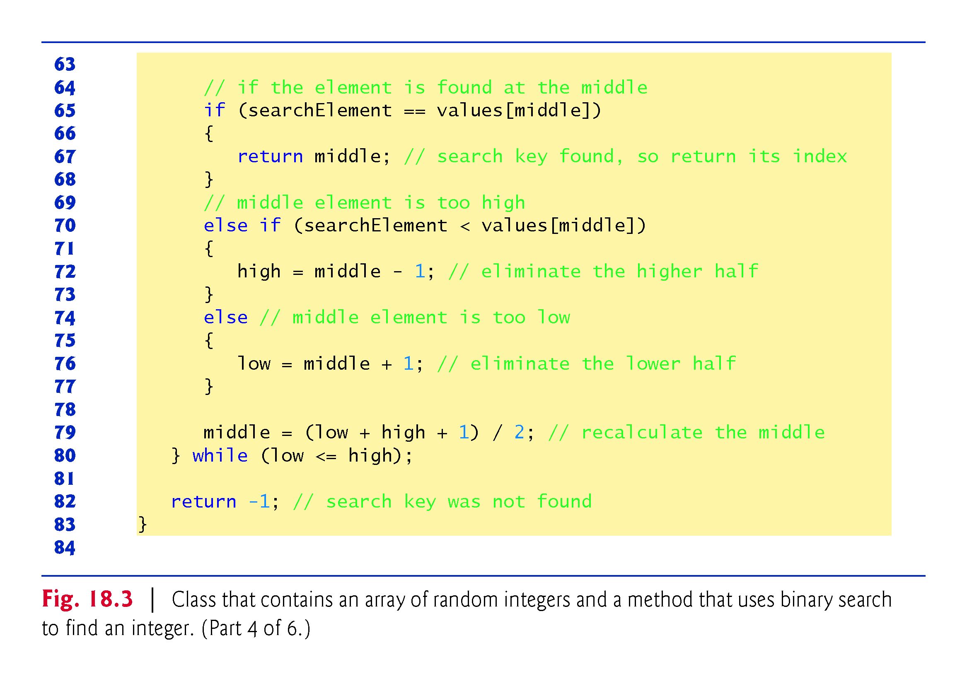
While the array is not empty

Slide 38
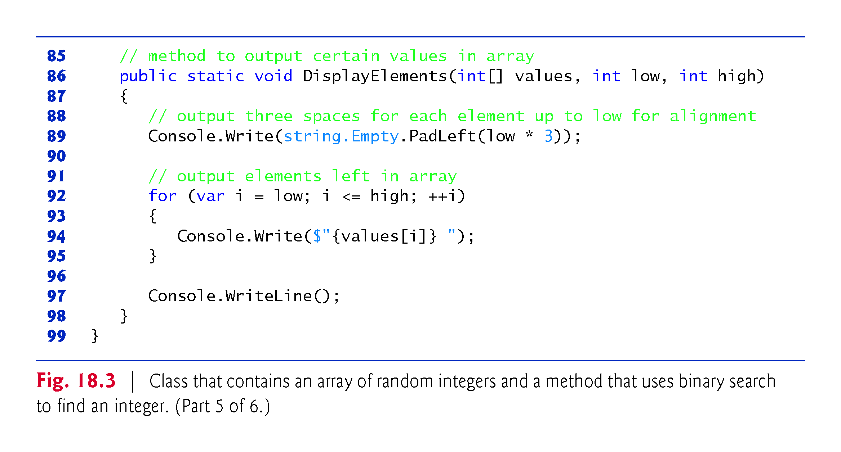

Slide 39
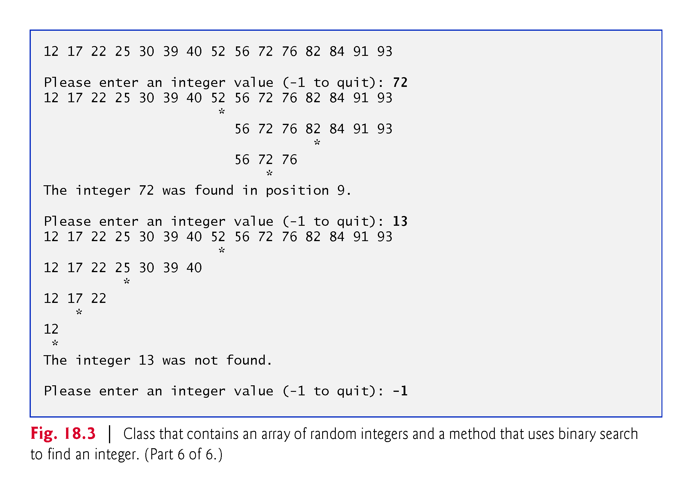
sorted

Slide 40
18.2.2 Binary Search (cont.)
Lines 27–47 of Fig. 18.5 loop until the user enters -1.
For each other number the user enters, the app performs a binary search to determine whether the number matches an element in the array.
The first line of output from this app is the array of ints, in increasing order.
When the user instructs the app to search for 72, the app first tests the middle element (indicated by * in the sample output), which is 52.

Slide 41
18.2.2 Binary Search (cont.)
The search key is greater than 52, so the app eliminates from consideration the first half of the array and tests the middle element from the second half. The search key is smaller than 82, so the app eliminates from consideration the second half of the subarray, leaving only three elements.
Finally, the app checks 72 (which matches the search key) and returns the index 9.

Slide 42
18.2.2 Binary Search (cont.)
Efficiency of Binary Search
In the worst-case scenario, searching a sorted array of 1,023 elements will take only 10 comparisons when using a binary search.
Repeatedly dividing 1,023 by 2 (because after each comparison, we are able to eliminate half of the array) and rounding down (because we also remove the middle element) yields the values 511, 255, 127, 63, 31, 15, 7, 3, 1 and 0.
The number 1023 (2¹⁰ – 1) is divided by 2 only 10 times to get the value 0, which indicates that there are no more elements to test.

Slide 43
18.2.2 Binary Search (cont.)
Dividing by 2 is equivalent to one comparison in the binary search algorithm. Thus, an array of 1,048,575 (220 – 1) elements takes a maximum of 20 comparisons to find the key, and an array of one billion elements (which is less than 230 – 1) takes a maximum of 30 comparisons to find the key.
This is a tremendous improvement in performance over the linear search.
The maximum number of comparisons needed for the binary search of any sorted array is the exponent of the first power of 2 greater than?? the number of elements in the array, which is represented as log₂ n.
Notes:
Exponent指数
Zhǐshù

Slide 44
18.2.2 Binary Search (cont.)
All logarithms grow at roughly the same rate, so in Big O notation the base can be omitted.
This results in a big O of O(log n) for a binary search, which is also known as logarithmic runtime.
Notes:
Logarithms 对数
Duì shù
Logarithmic
ˌlôɡəˈriT͟Hmik
对数的
Duì shǔ de

Slide 45
18.3 Sorting Algorithms
Sorting data (i.e., placing the data in some particular order, such as ascending or descending) is one of the most important computing applications.
Virtually every organization must sort some data—often, massive amounts of it.
Sorting data is an intriguing, compute-intensive problem that has attracted substantial research efforts.
Notes:
Intriguing 耐人寻味的 Nàirénxúnwèi de

Slide 46
18.3 Sorting Algorithms
It’s important to understand about sorting that the end result—the sorted array—will be the same no matter which (correct) algorithm you use to sort the array.
The choice of algorithm affects only the runtime and memory use of the app.
The rest of the chapter introduces three common sorting algorithms.
The first two—selection sort and insertion sort—are simple to program, but inefficient.
The last—merge sort—is much faster than selection sort and insertion sort but more difficult to program. We focus on sorting arrays of simple-type data, namely ints.
It’s possible to sort arrays of objects as well—we discuss this in Chapter 21, Collections.

Slide 47
18.3.1 Selection Sort
Selection sort is a simple, but inefficient, sorting algorithm.
The first iteration of the algorithm selects the smallest element in the array and swaps it with the first element.
The second iteration selects the second-smallest element (which is the smallest of the remaining elements) and swaps it with the second element.
The algorithm continues until the last iteration selects the second-largest element and, if necessary, swaps it with the second-to-last element, leaving the largest element in the last position.
After the ith iteration, the smallest i elements of the array will be sorted in increasing order in the first i positions of the array.

Slide 48
18.3.1 Selection Sort (cont.)
As an example, consider the array
34 56 4 10 77 51 93 30 5 52
An app that implements selection sort first determines the smallest element (4) of this array, which is contained in index 2 (i.e., position 3).
The app swaps 4 with 34, resulting in
4 56 34 10 77 51 93 30 5 52
The app then determines the smallest value of the remaining elements (all elements except 4), which is 5, contained in index 8.
The app swaps 5 with 56, resulting in
4 5 34 10 77 51 93 30 56 52

Slide 49
18.3.1 Selection Sort (cont.)
On the third iteration, the app determines the next smallest value (10) and swaps it with 34.
4 5 10 34 77 51 93 30 56
The process continues until the array is fully sorted.
4 5 10 30 34 51 52 56 77 93
After the first iteration, the smallest element is in the first position.
After the second iteration, the two smallest elements are in order in the first two positions.
After the third iteration, the three smallest elements are in order in the first three positions.

Slide 50
18.3.1 Selection Sort (cont.)
Figure 18.64 declares class SelectionSortTest to implement and test a selection sort.
Main creates and initializes array data with random ints in the range 10–99.

Slide 51
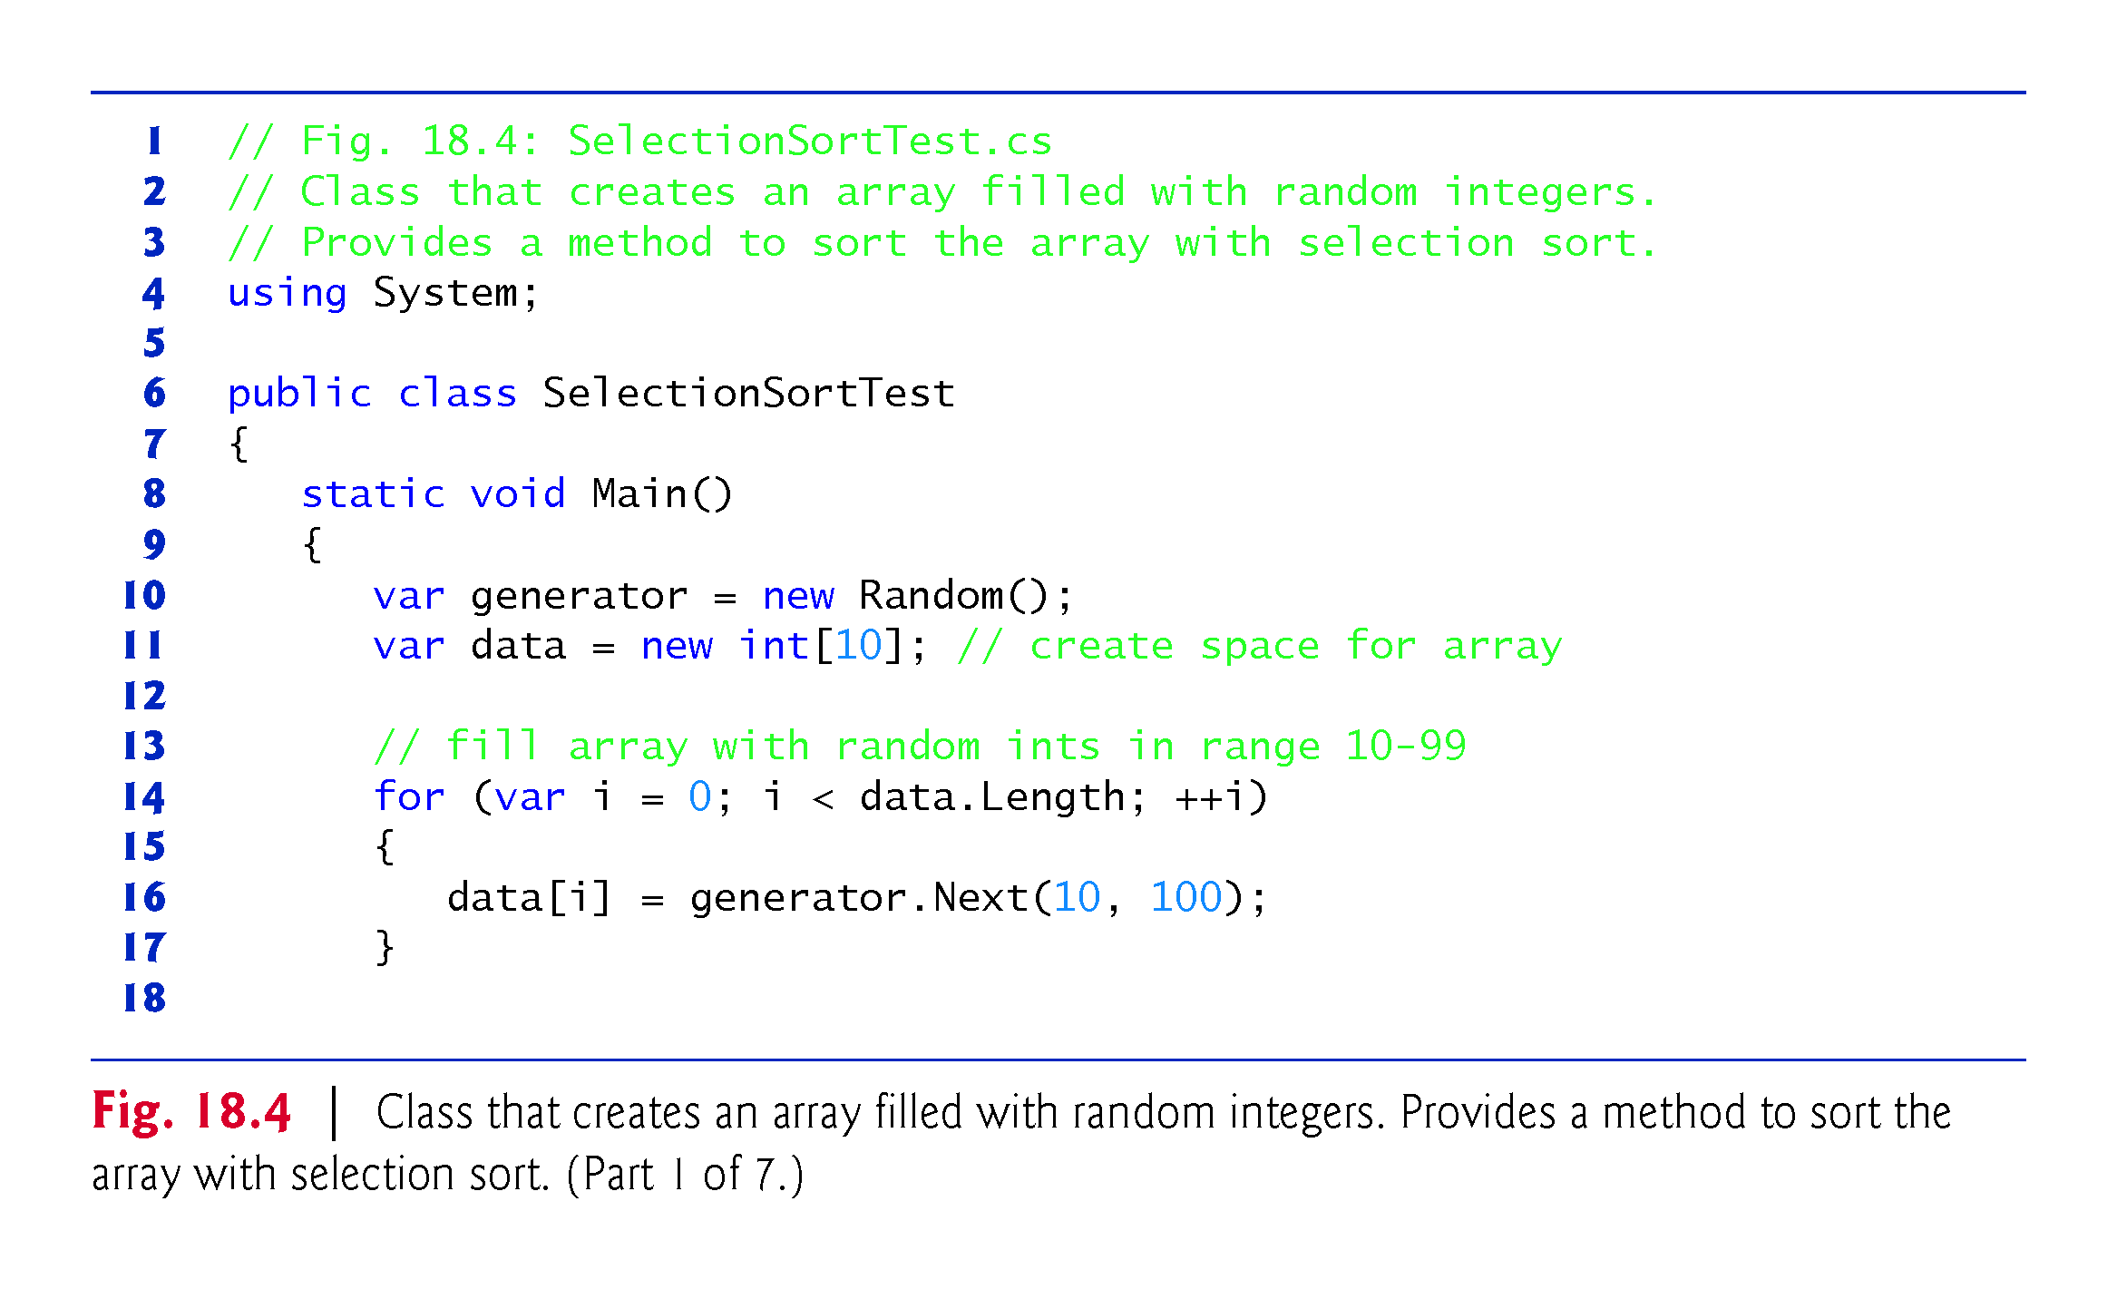

Slide 52
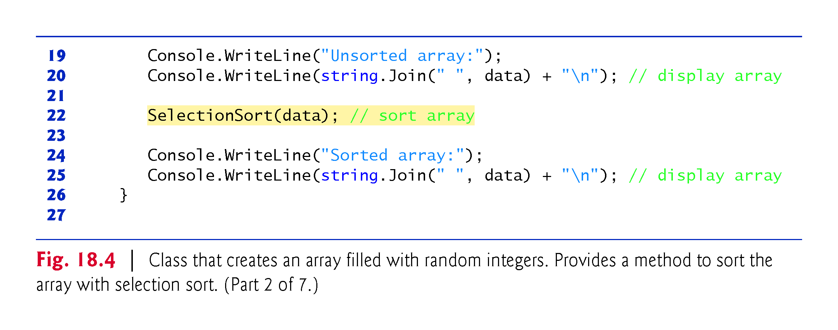

Slide 53
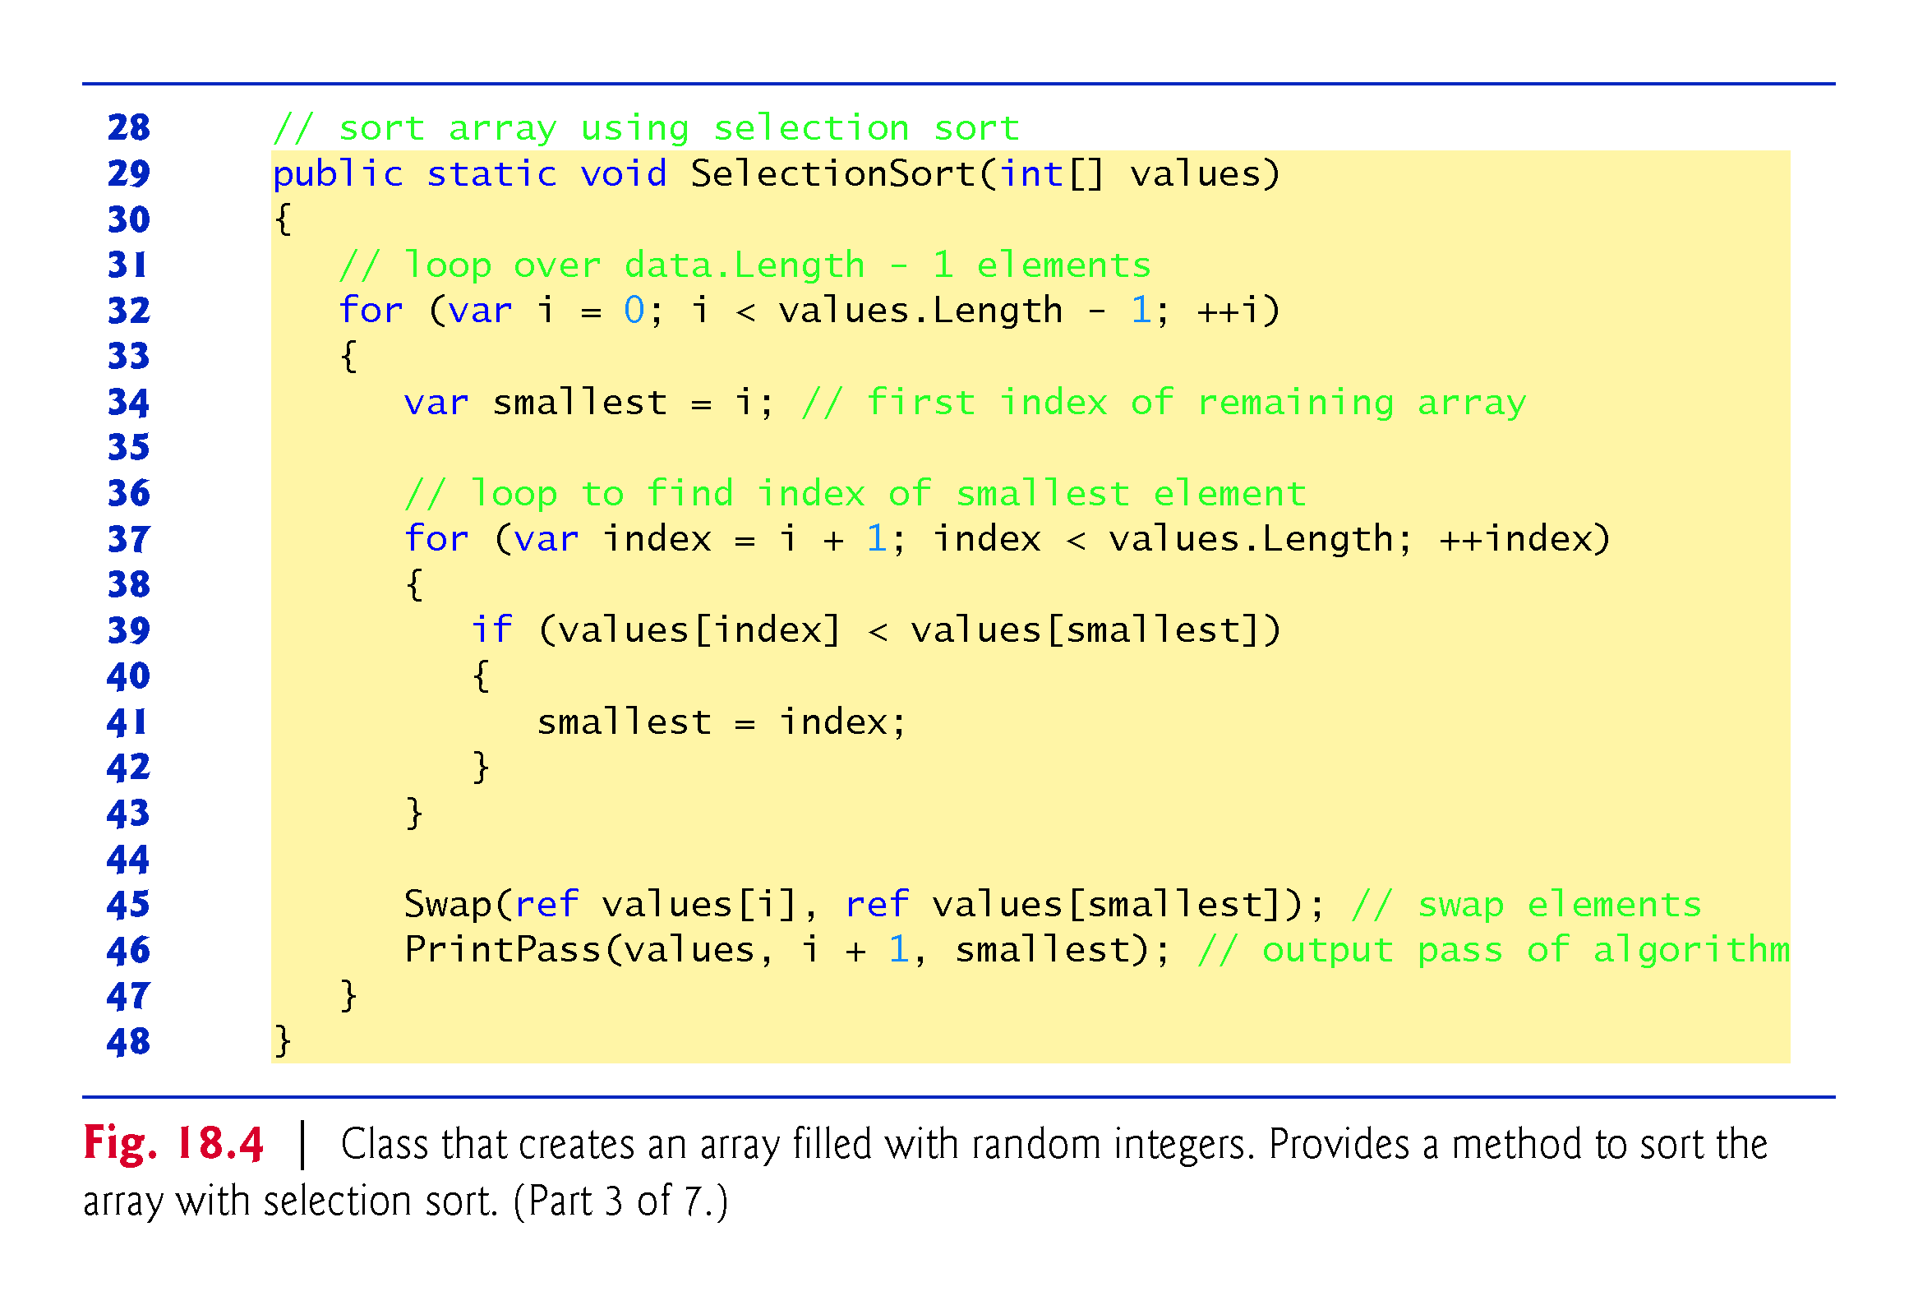
Update smallest

Slide 54
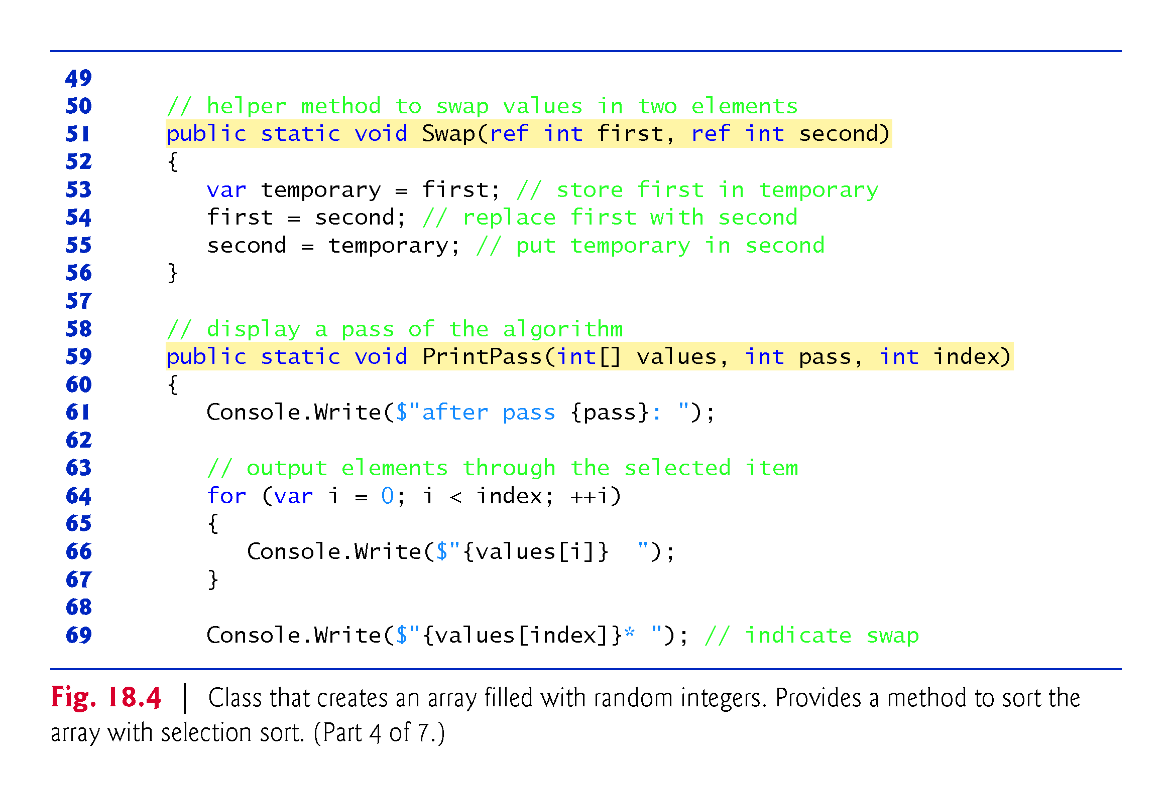

Slide 55
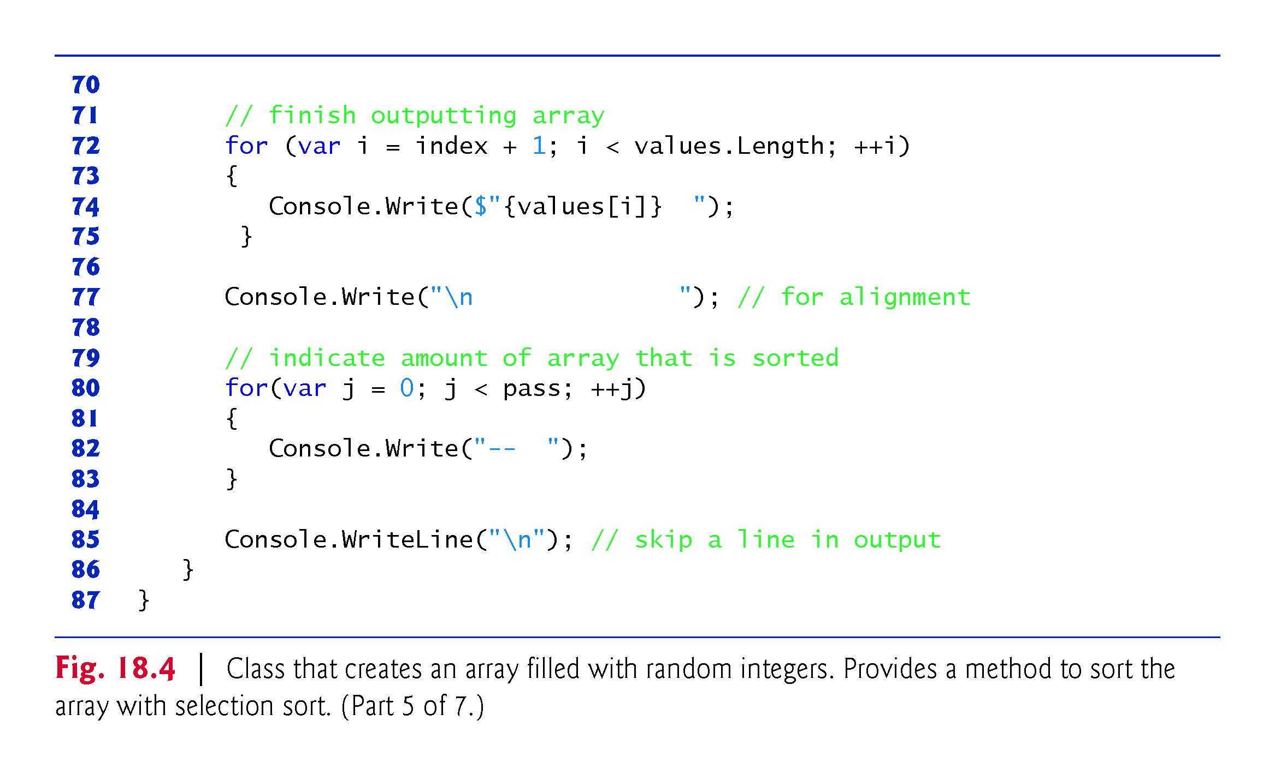

Slide 56
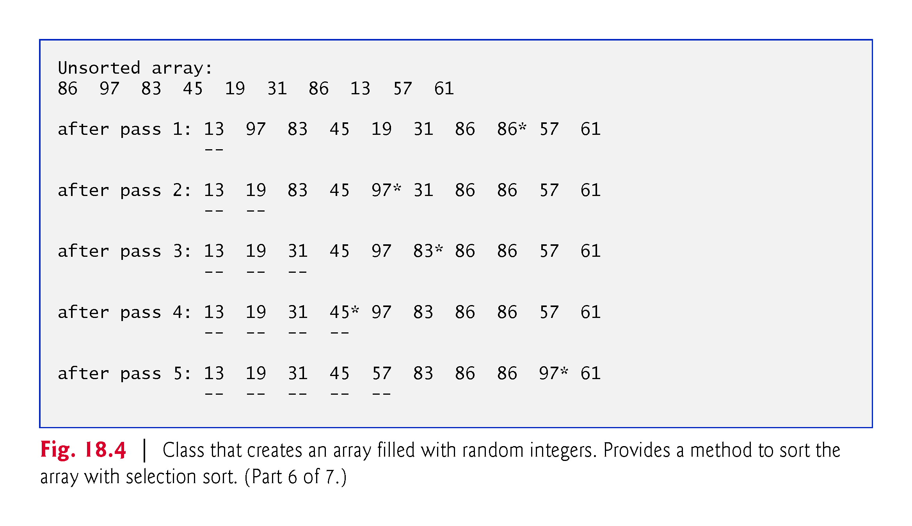

Slide 57
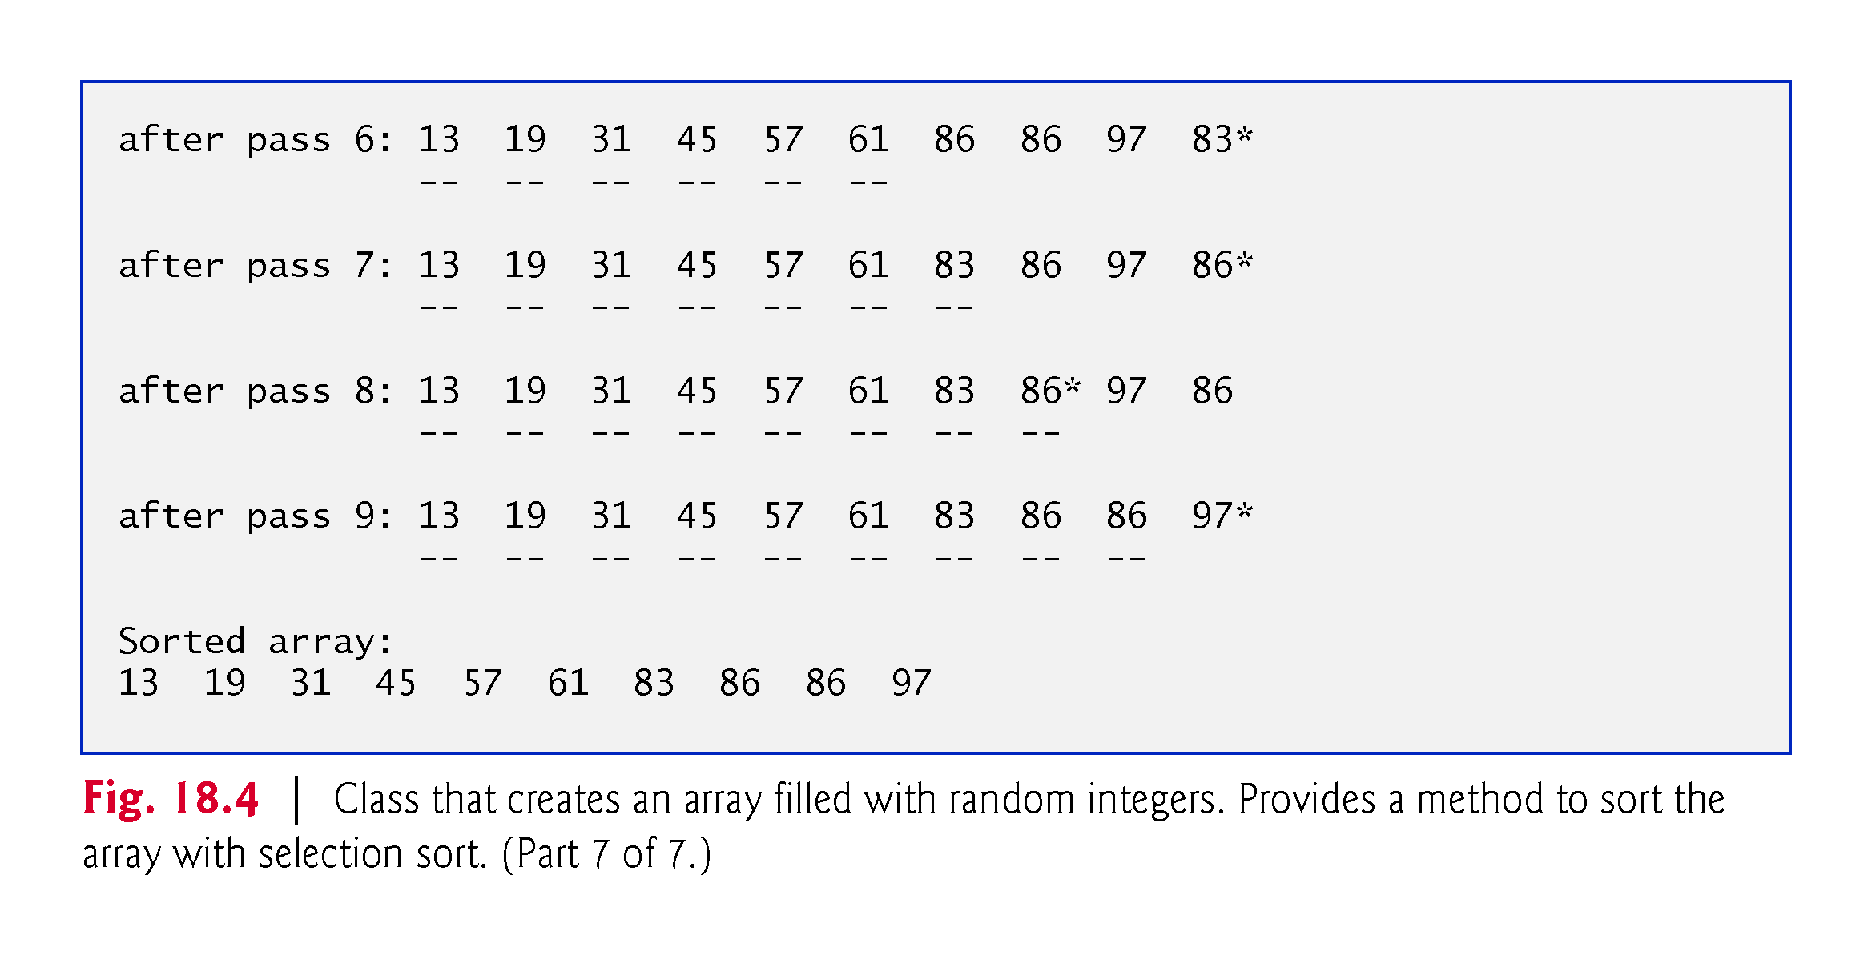

Slide 58
18.3.1 Selection Sort (cont.)
Line 22 calls method SelectionSort (Fig. 18.6, lines 22–39), which sorts the elements using selection sort.
The output uses dashes to indicate the portion of the array that is sorted after each pass.
An asterisk is placed next to the position of the element that was swapped with the smallest element on that pass.
On each pass, the element next to the asterisk and the element above the rightmost set of dashes were the two values that were swapped.

Slide 59
18.3.2 Insertion Sort
Insertion sort is another simple, but inefficient, sorting algorithm.
Its first iteration takes the second element in the array and, if it’s less than the first, swaps them.
The second iteration looks at the third element and inserts it in the correct position with respect to the first two elements (moving them as necessary), so all three elements are in order.
At the ith iteration of this algorithm, the first i elements in the original array will be sorted.

Slide 60
18.3.2 Insertion Sort (cont.)
Consider as an example the following array, which is identical to the array we used in the discussions of selection sort and merge sort.
34 56 4 10 77 51 93 30 5 52
An app that implements the insertion sort algorithm first looks at the first two elements of the array, 34 and 56.
These are already in order, so the app continues (if they were out of order, it would swap them).

Slide 61
18.3.2 Insertion Sort (cont.)
In the next iteration, the app looks at the third value, 4.
This value is less than 56, so the app stores 4 in a temporary variable and moves 56 one element to the right. The app then checks and determines that 4 is less than 34, so it moves 34 one element to the right.
The app has now reached the beginning of the array, so it places 4 in the zeroth position.
The array now is
4 34 56 10 77 51 93 30 5 52

Slide 62
18.3.2 Insertion Sort (cont.)
In the next iteration, the app stores the value 10 in a temporary variable.
Then the app compares 10 to 56 and moves 56 one element to the right because it’s larger than 10.
The app then compares 10 to 34, moving 34 one element to the right. When the app compares 10 to 4, it observes that 10 is larger than 4 and places 10 in element 1.
The array now is
4 10 34 56 77 51 93 30 5 52
Using this algorithm, at the ith iteration, the original array’s first i elements are sorted, but they may not be in their final locations—smaller values may be located later in the array.

Slide 63
18.3.2 Insertion Sort (cont.)
Figure 18.5 declares the InsertionSortTest class to implement and test an insertion sort.

Slide 64
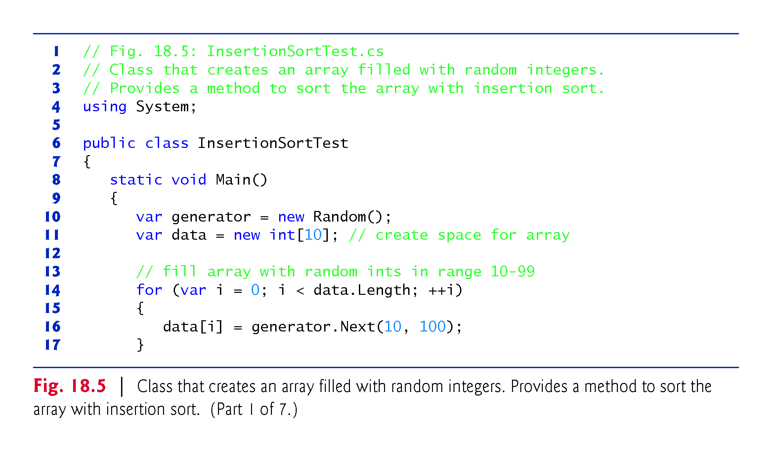

Slide 65
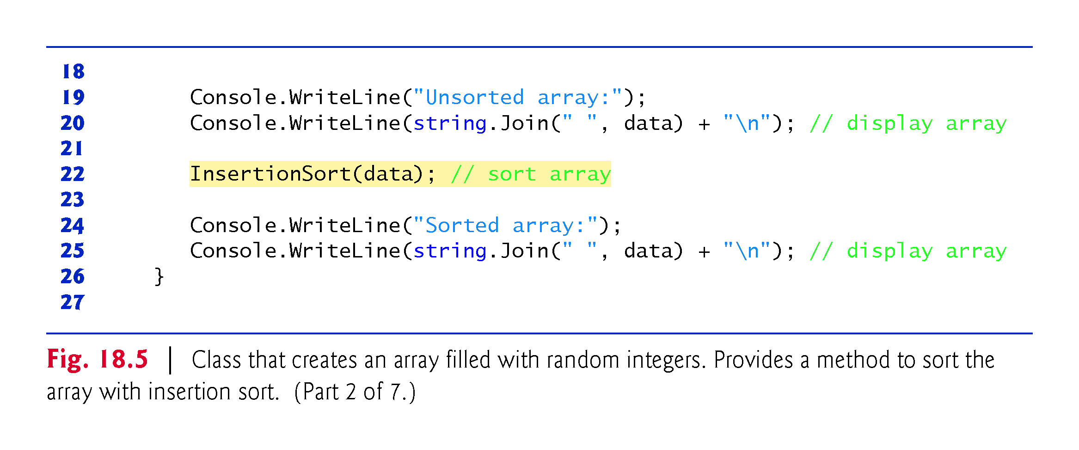

Slide 66
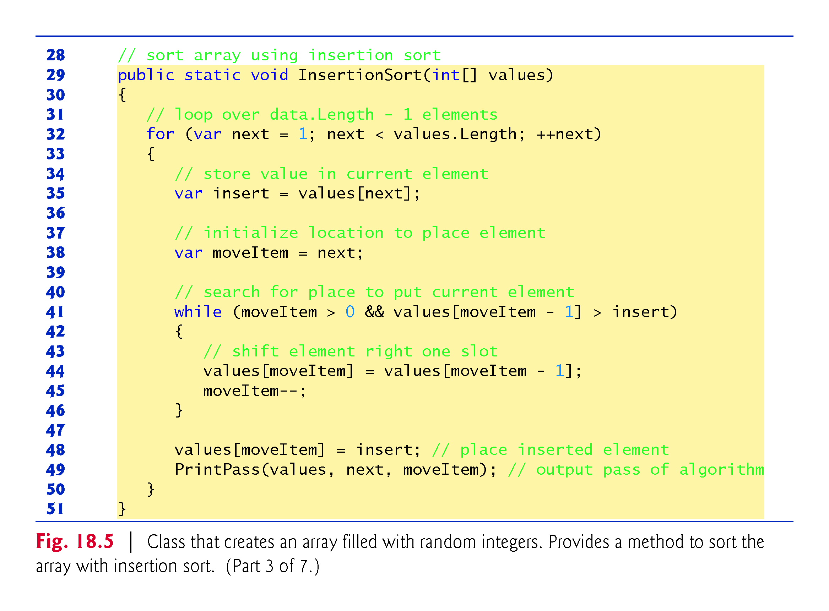

Slide 67
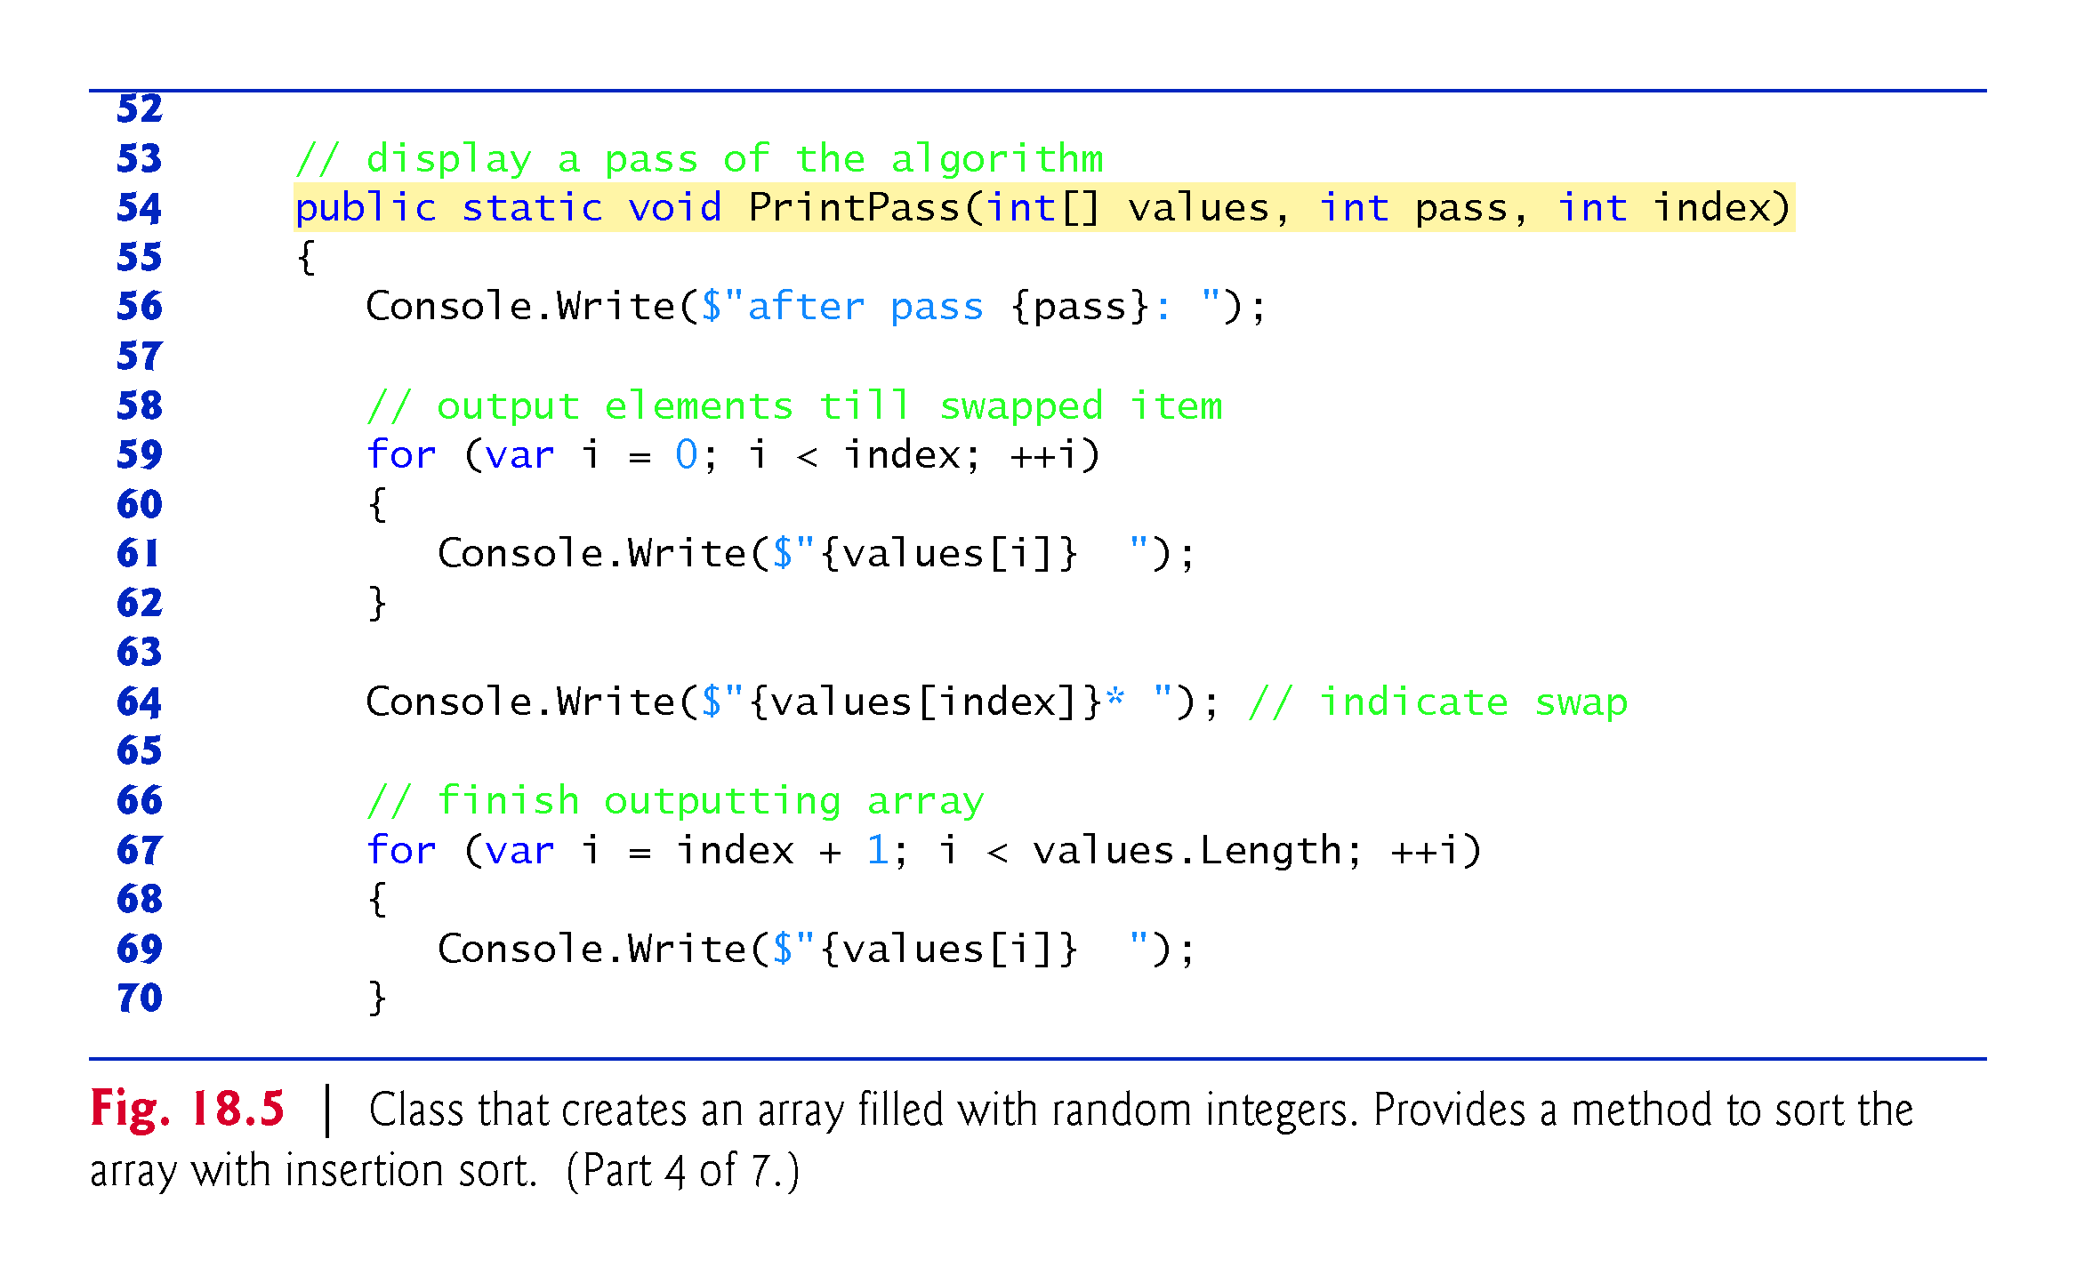

Slide 68
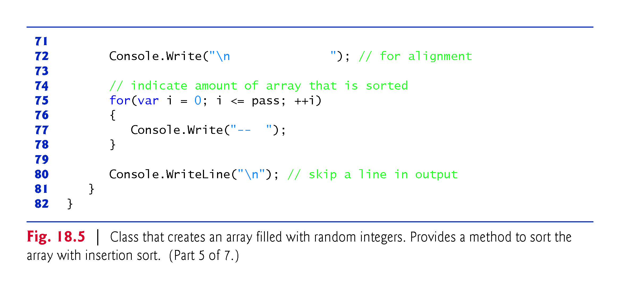

Slide 69
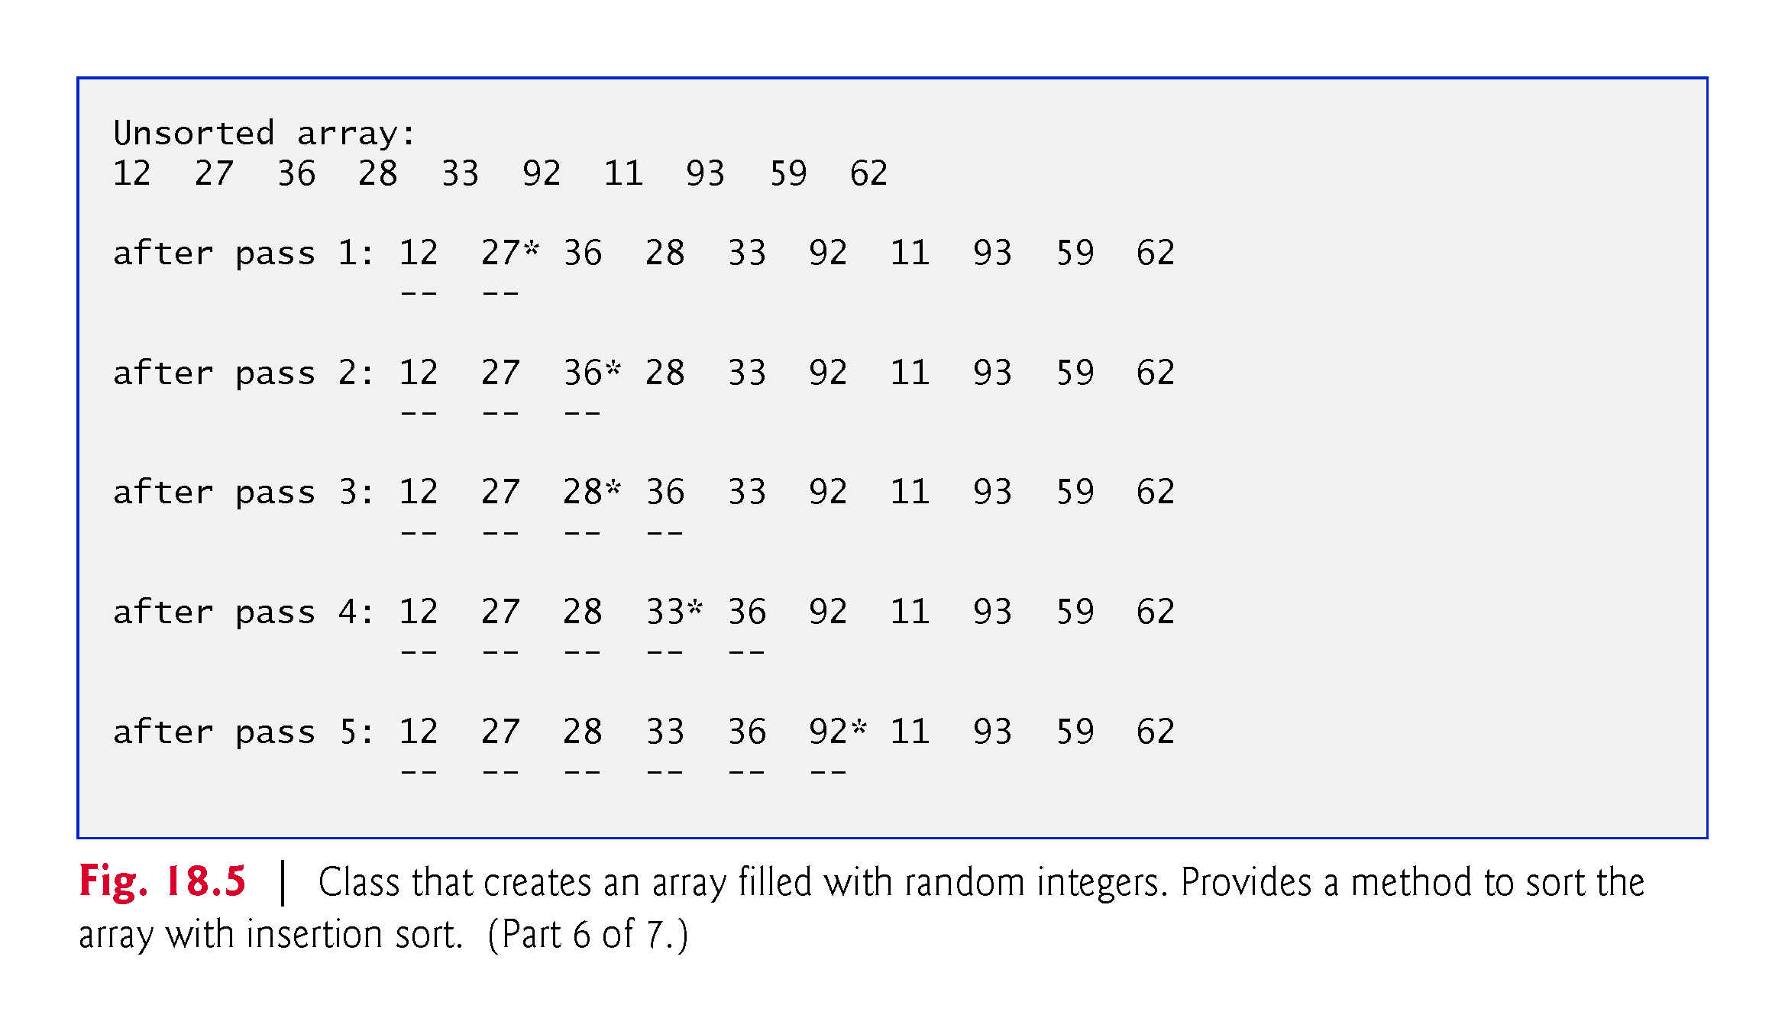

Slide 70
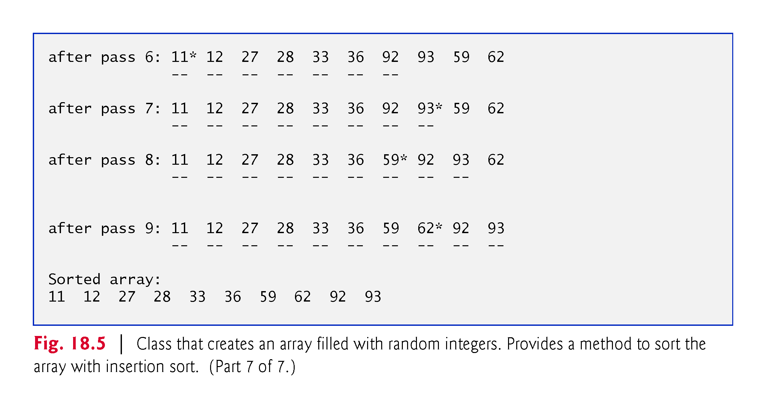

Slide 71
18.3.3 Merge Sort
Merge sort is an efficient sorting algorithm but is conceptually more complex than selection sort and insertion sort.
The merge sort algorithm sorts an array by splitting it into two equal-sized subarrays, sorting each subarray and merging them in one larger array.
With an odd number of elements, the algorithm creates the two subarrays such that one has one more element than the other.

Slide 72
18.3.3 Merge Sort (cont.)
The implementation of merge sort in this example is recursive. The base case is an array with one element.
A one-element array is, of course, sorted, so merge sort immediately returns when it’s called with a one-element array.
The recursion step splits an array in two approximately equal-length pieces, recursively sorts them and merges the two sorted arrays in one larger, sorted array.
Suppose the algorithm has already merged smaller arrays to create sorted arrays A:
4 10 34 56 77
and B:
5 30 51 52 93

Slide 73
18.3.3 Merge Sort (cont.)
Merge sort combines these two arrays in one larger, sorted array.
The smallest element in A is 4 (located in the zeroth element of A).
The smallest element in B is 5 (located in the zeroth element of B).
In order to determine the smallest element in the larger array, the algorithm compares 4 and 5.
The value from A is smaller, so 4 becomes the first element in the merged array.
The algorithm continues by comparing 10 (the second element in A) to 5 (the first element in B).
The value from B is smaller, so 5 becomes the second element in the larger array.
The algorithm continues by comparing 10 to 30, with 10 becoming the third element in the array, and so on.

Slide 74
18.3.3 Merge Sort (cont.)
Lines 29–31 of Fig. 18.6 declare the MergeSort method.
The output from this app displays the splits and merges performed by merge sort, showing the progress of the sort at each step of the algorithm.

Slide 75
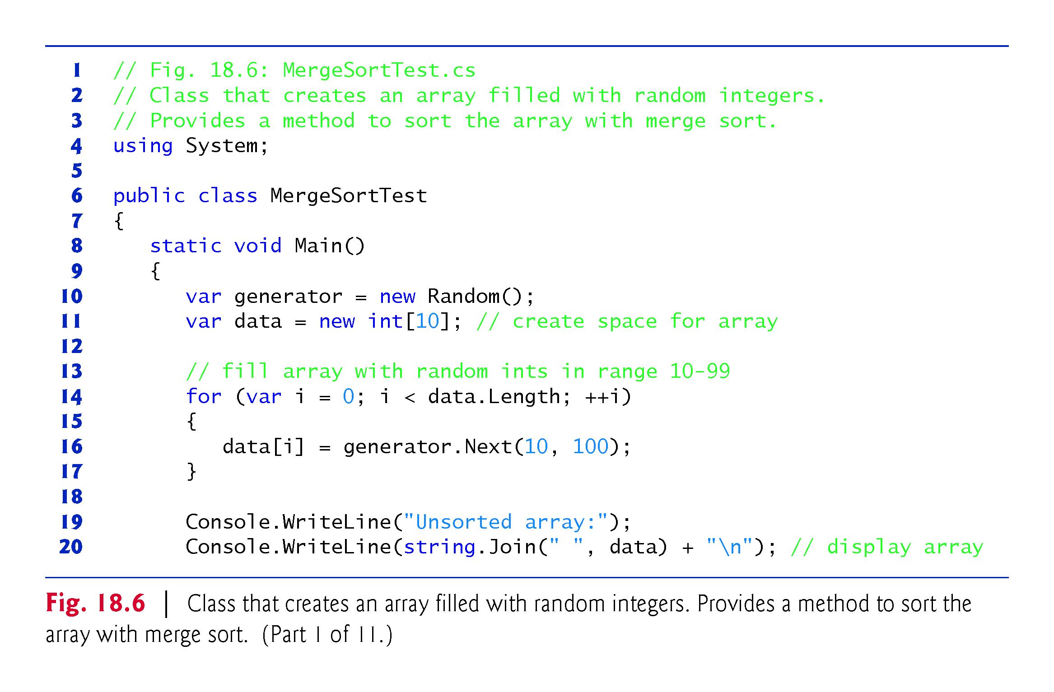

Slide 76
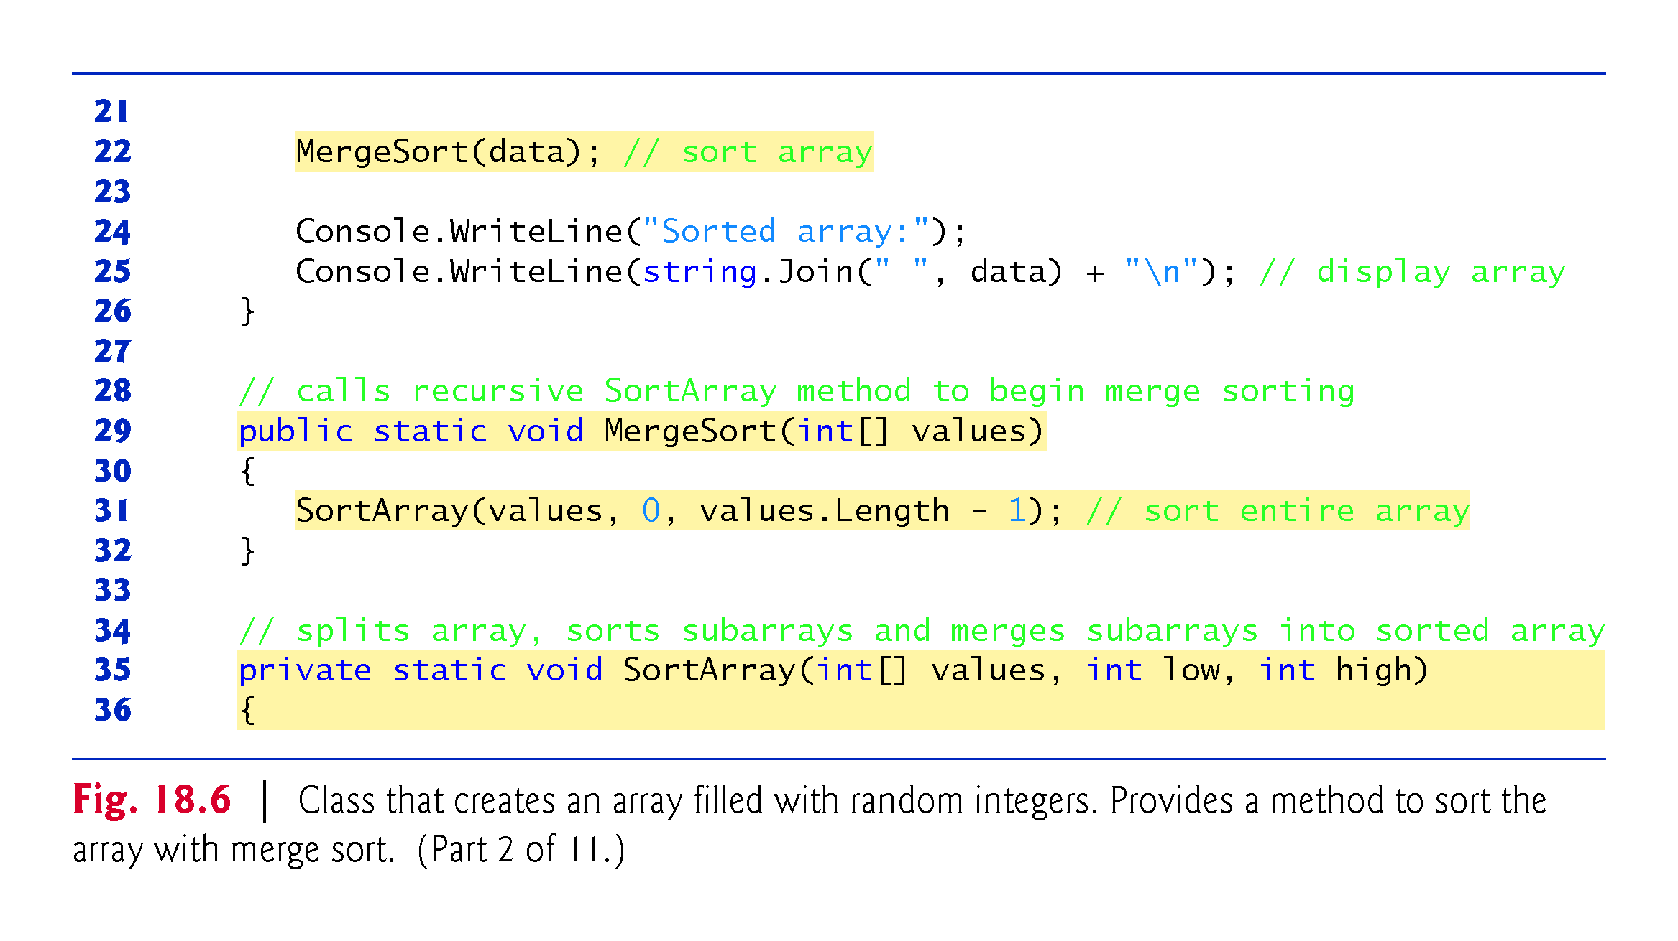

Slide 77
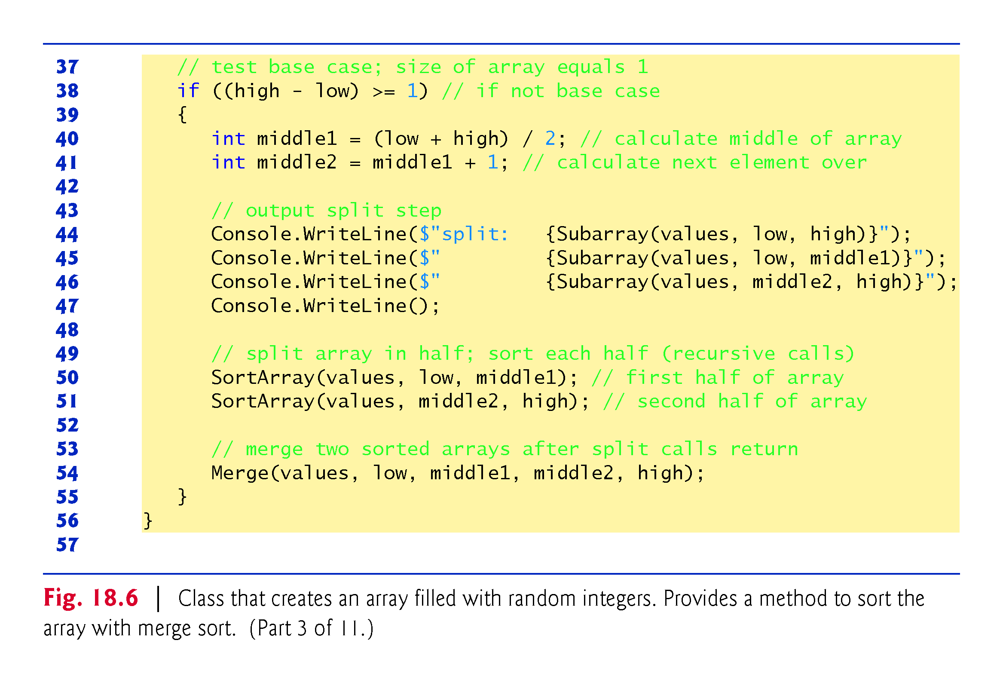

Slide 78
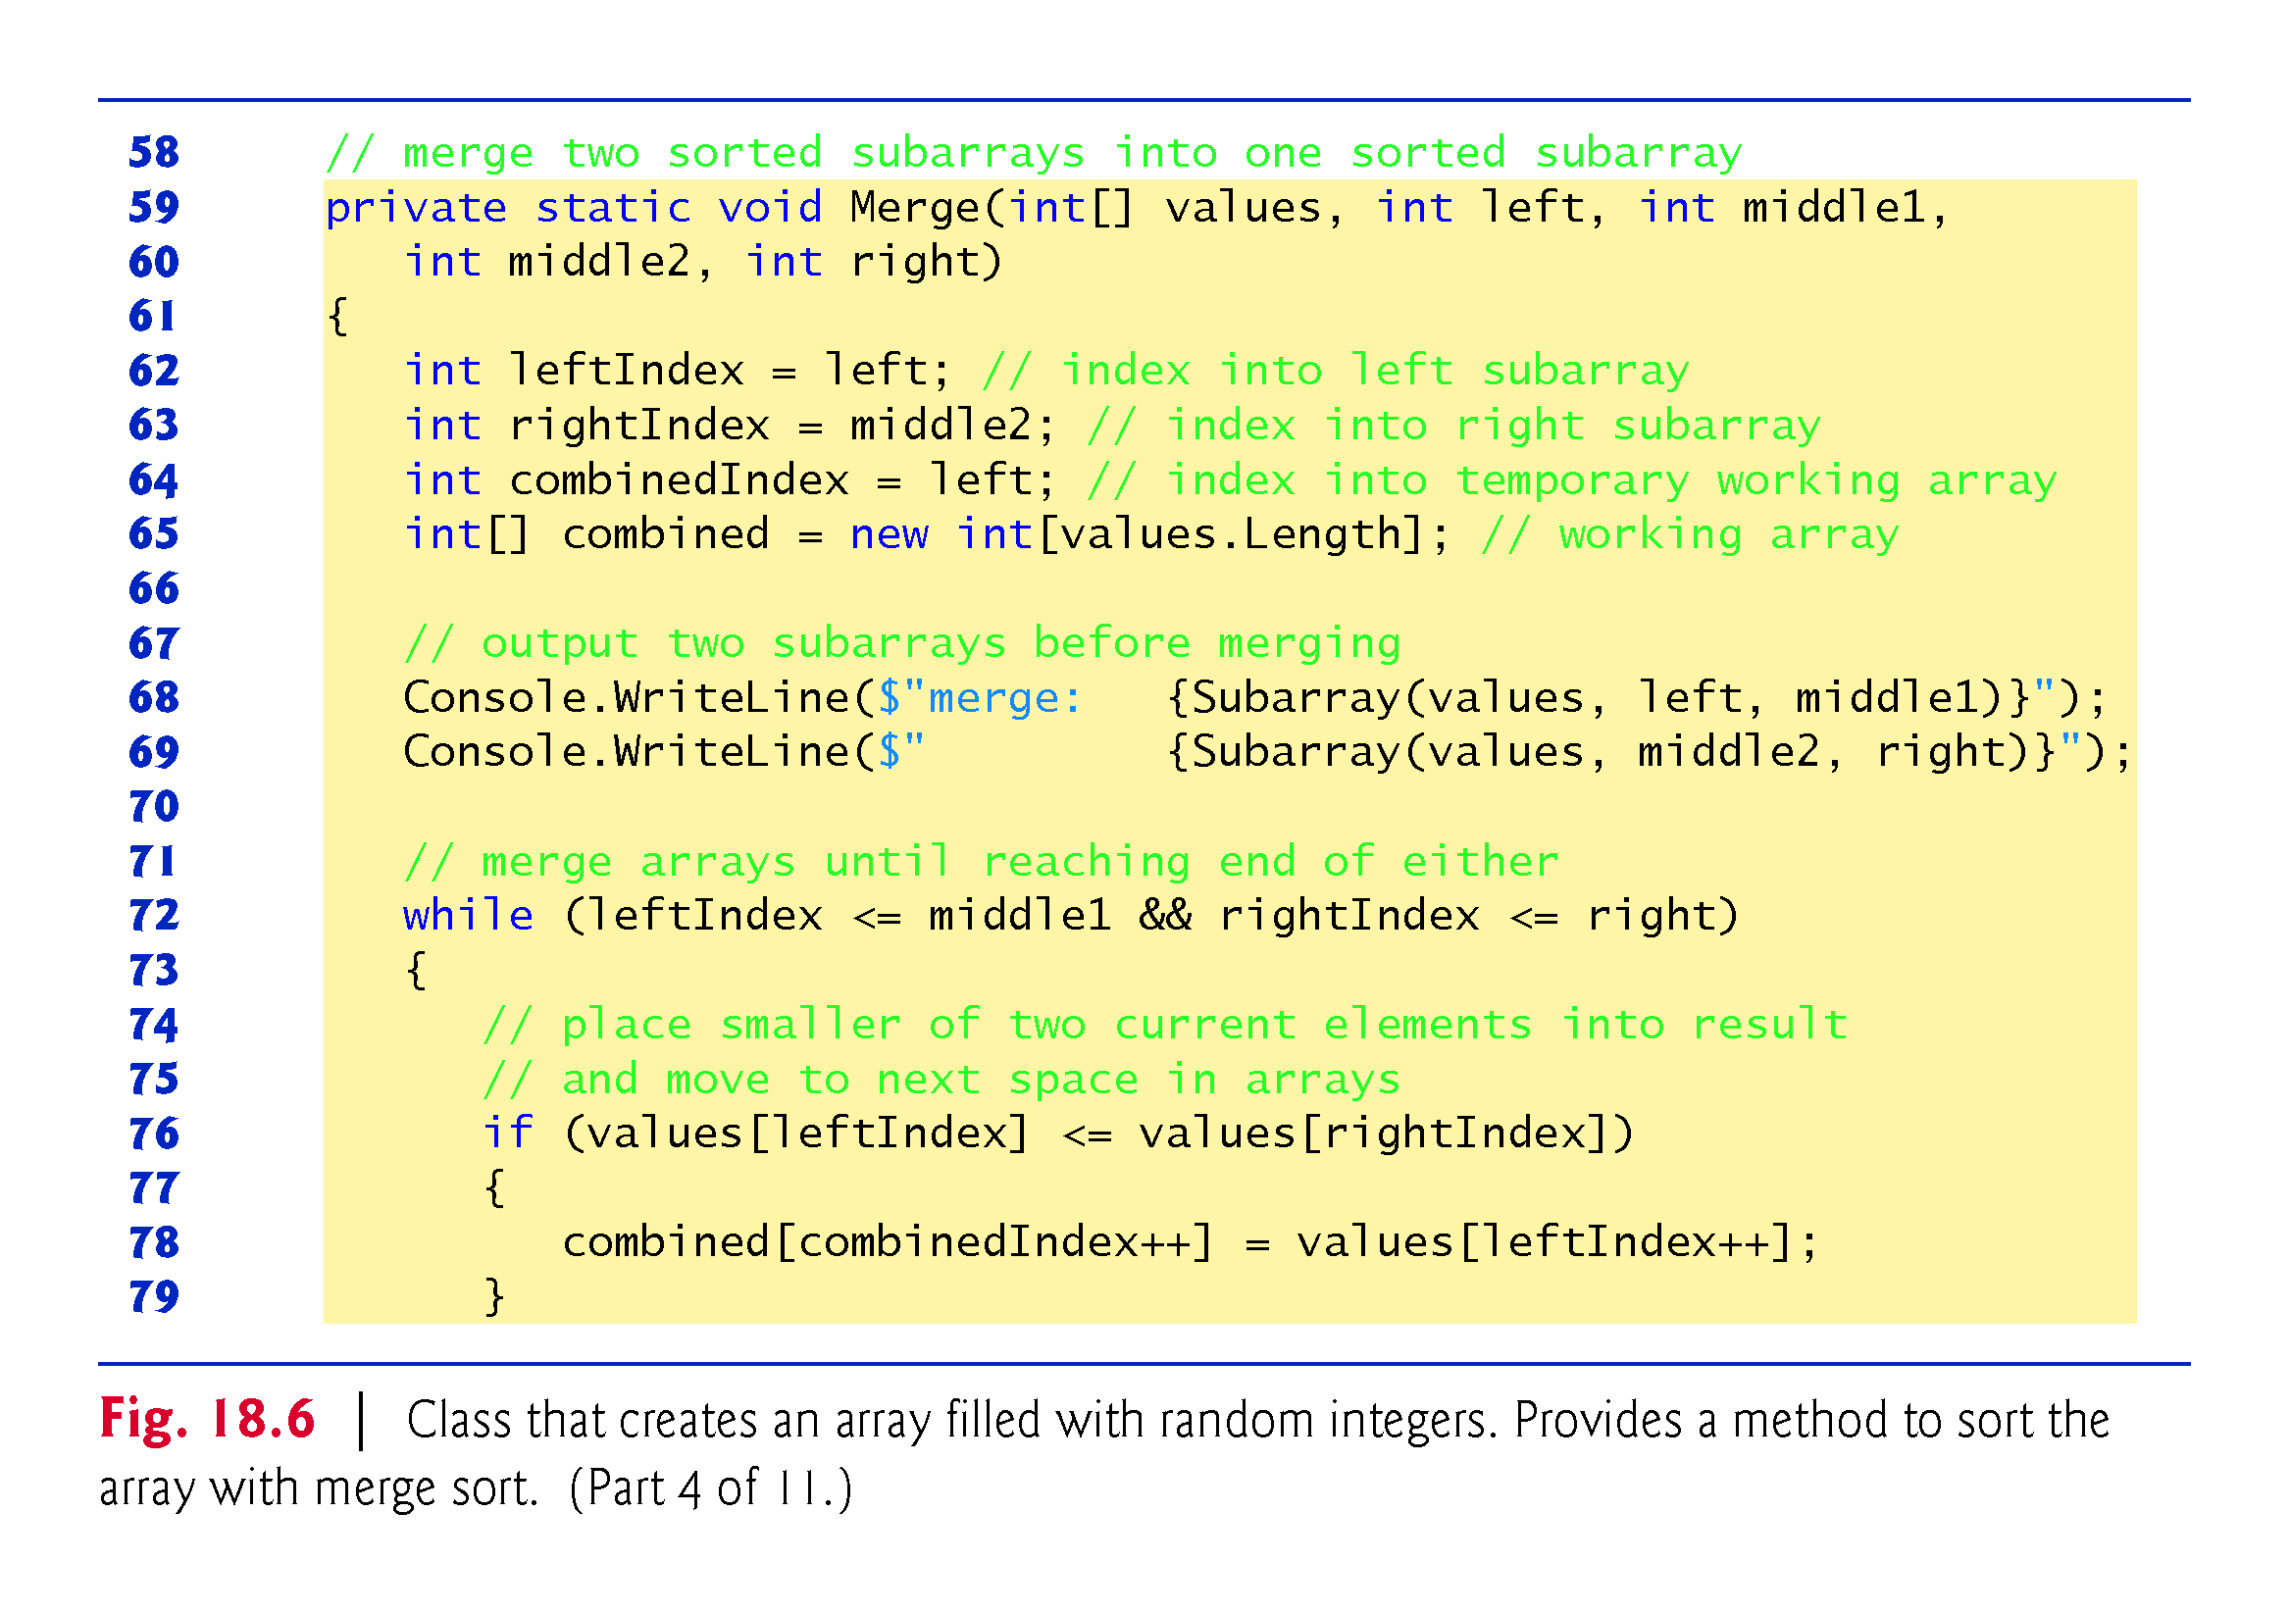

Slide 79
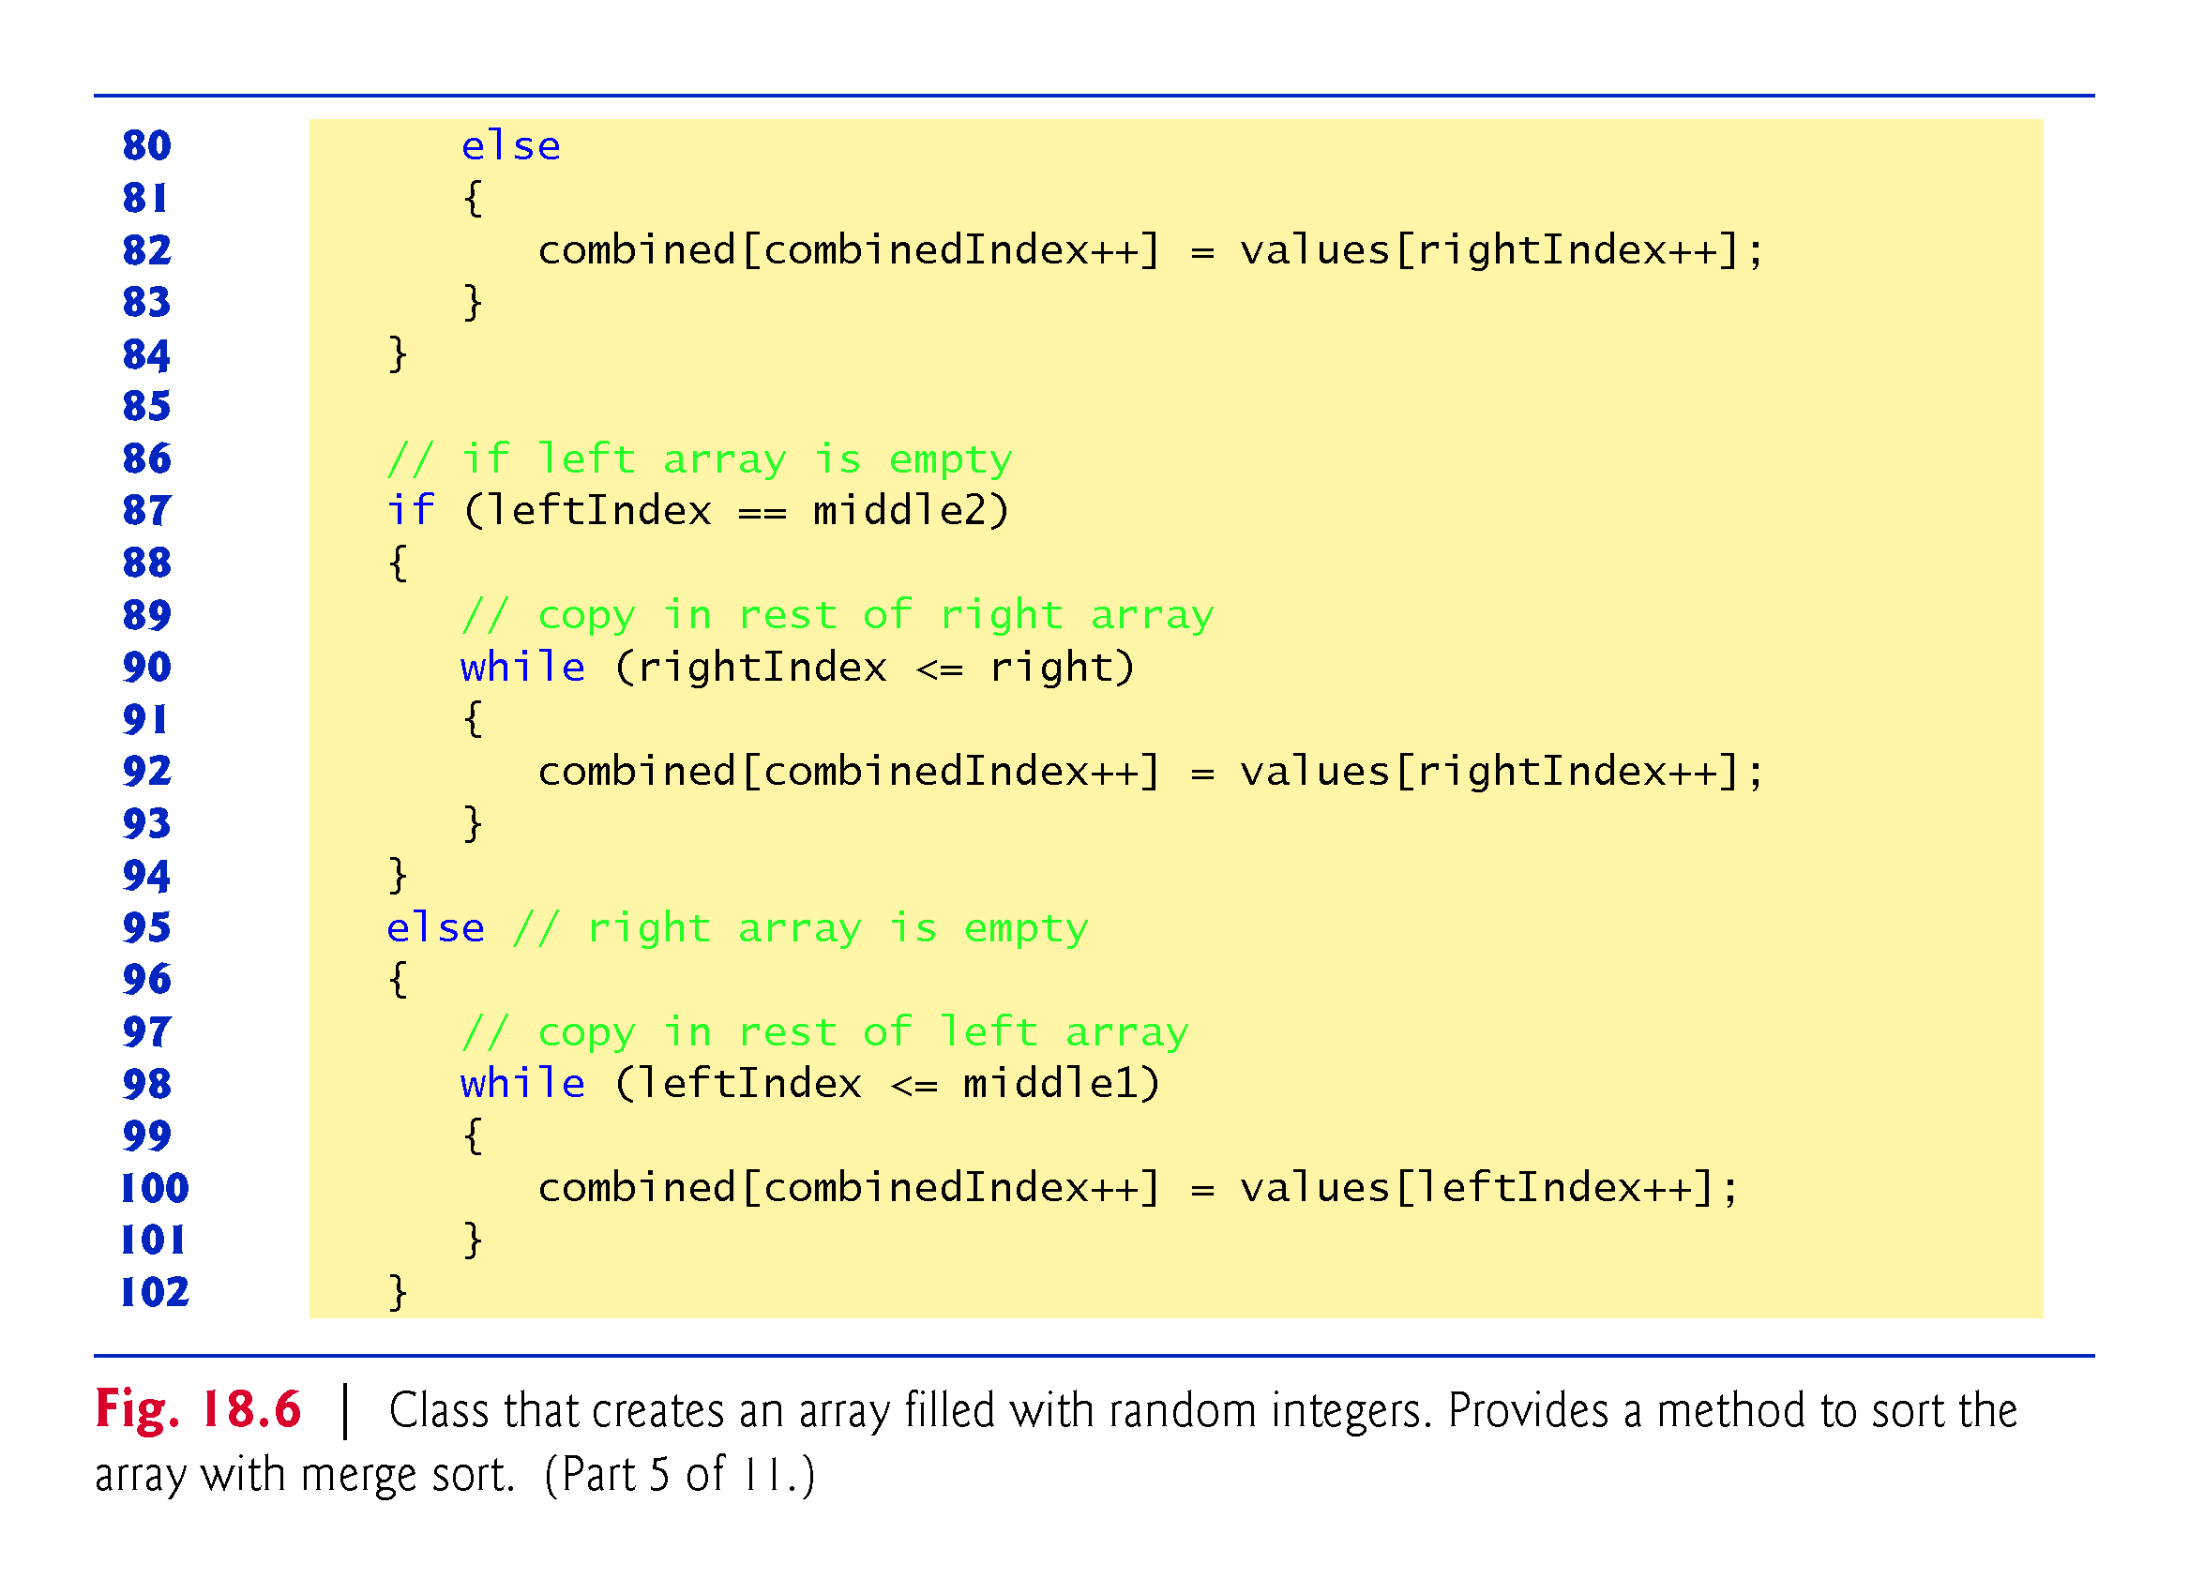

Slide 80
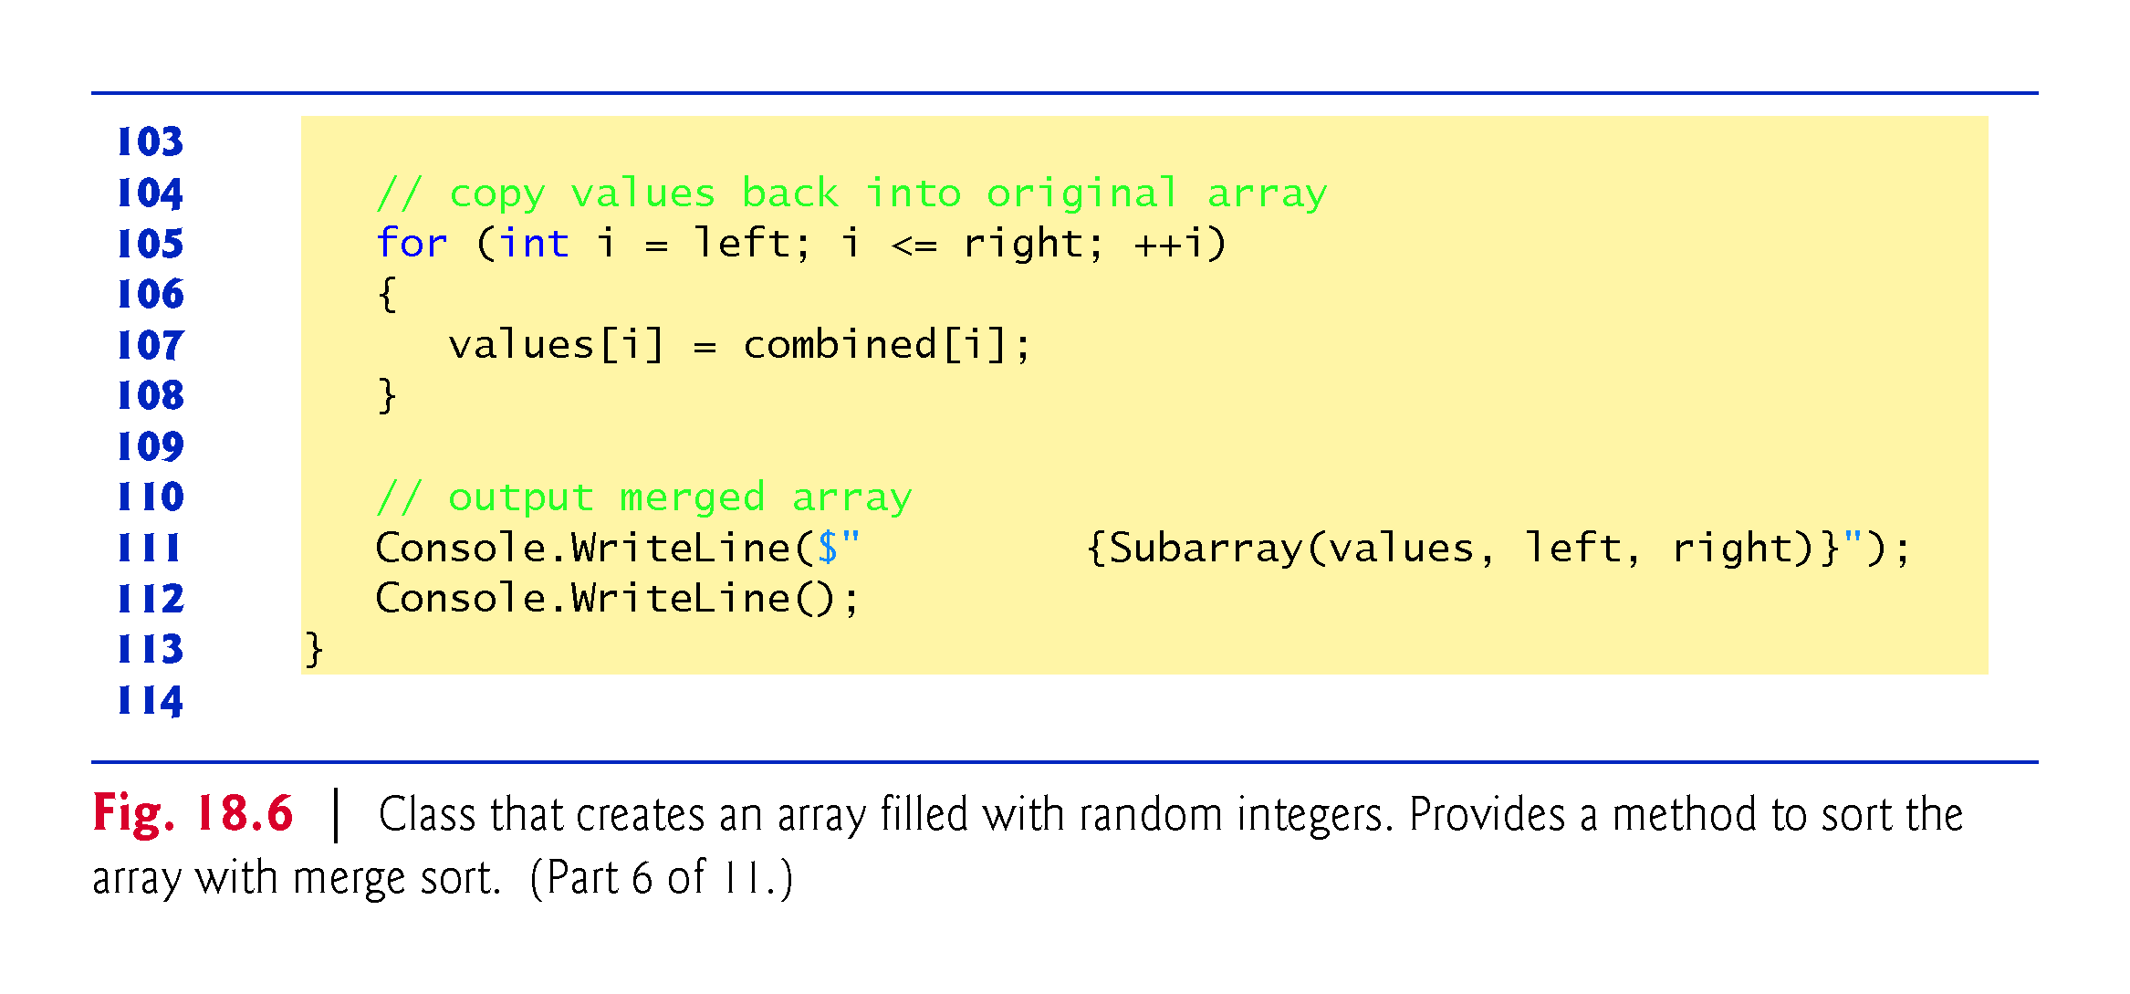

Slide 81
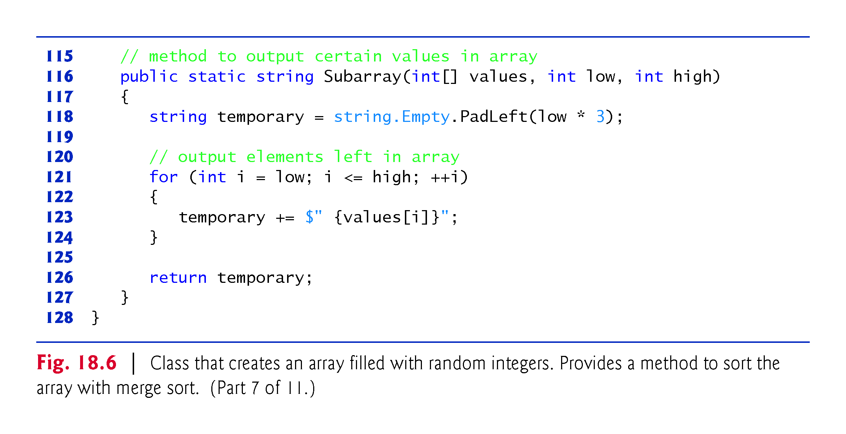

Slide 82
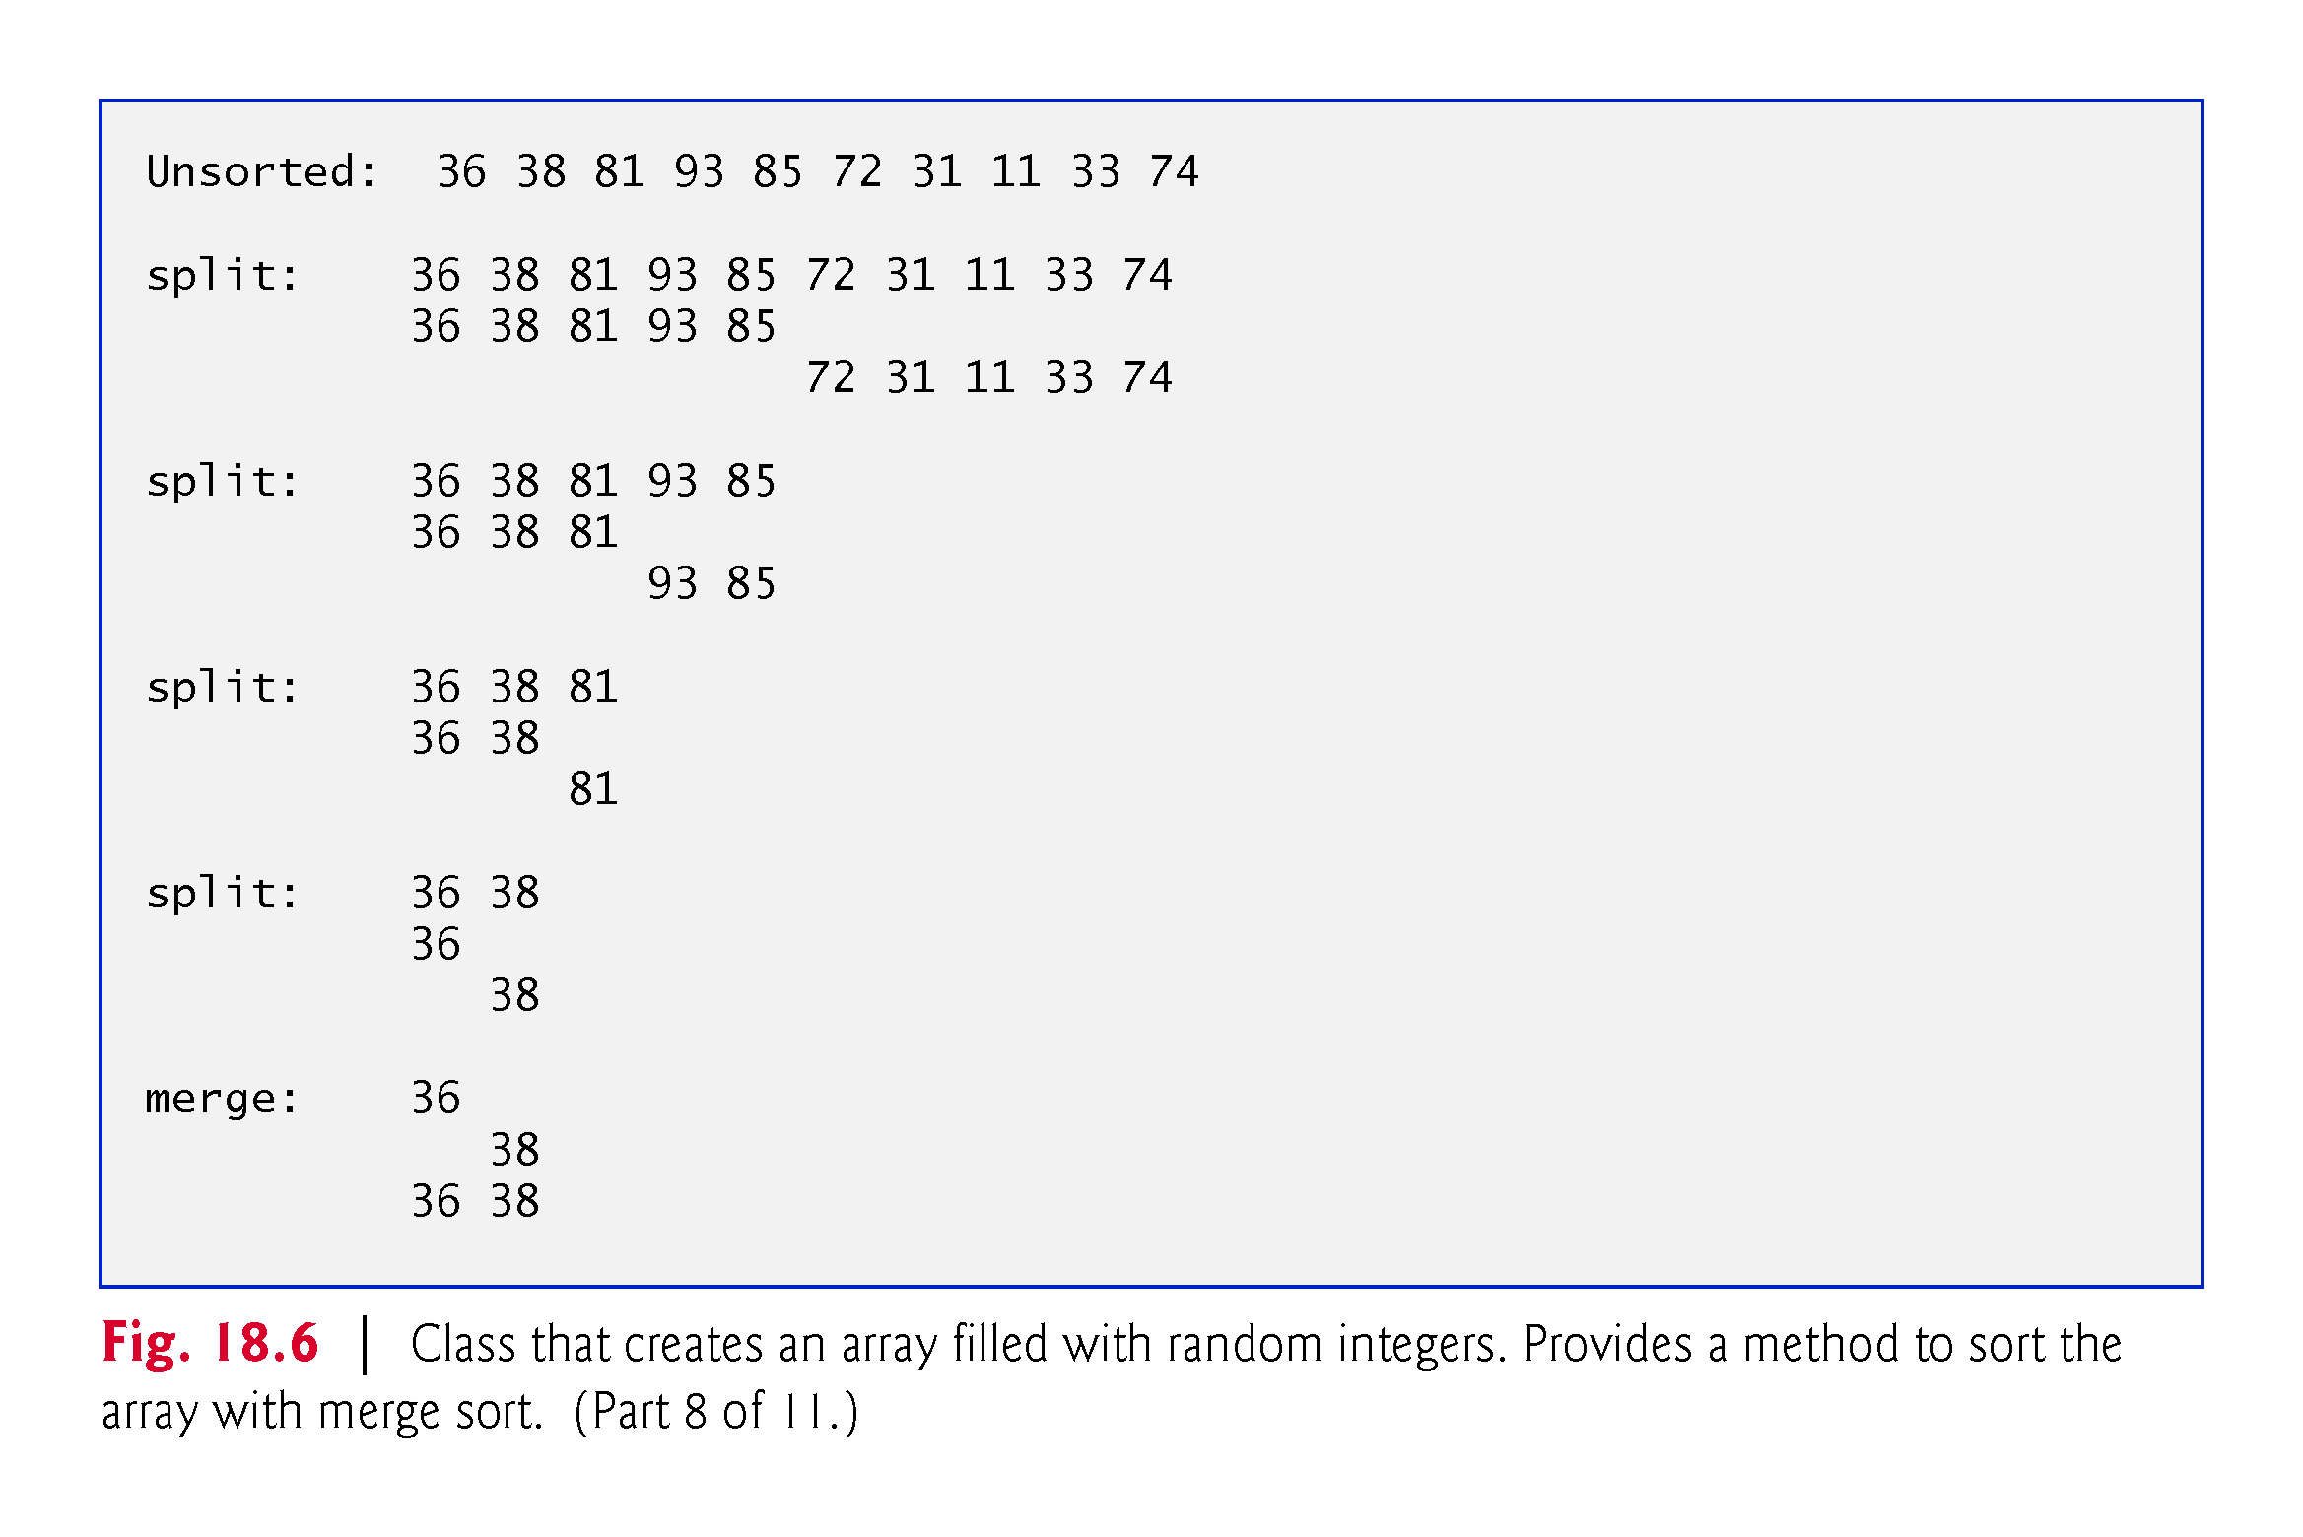

Slide 83
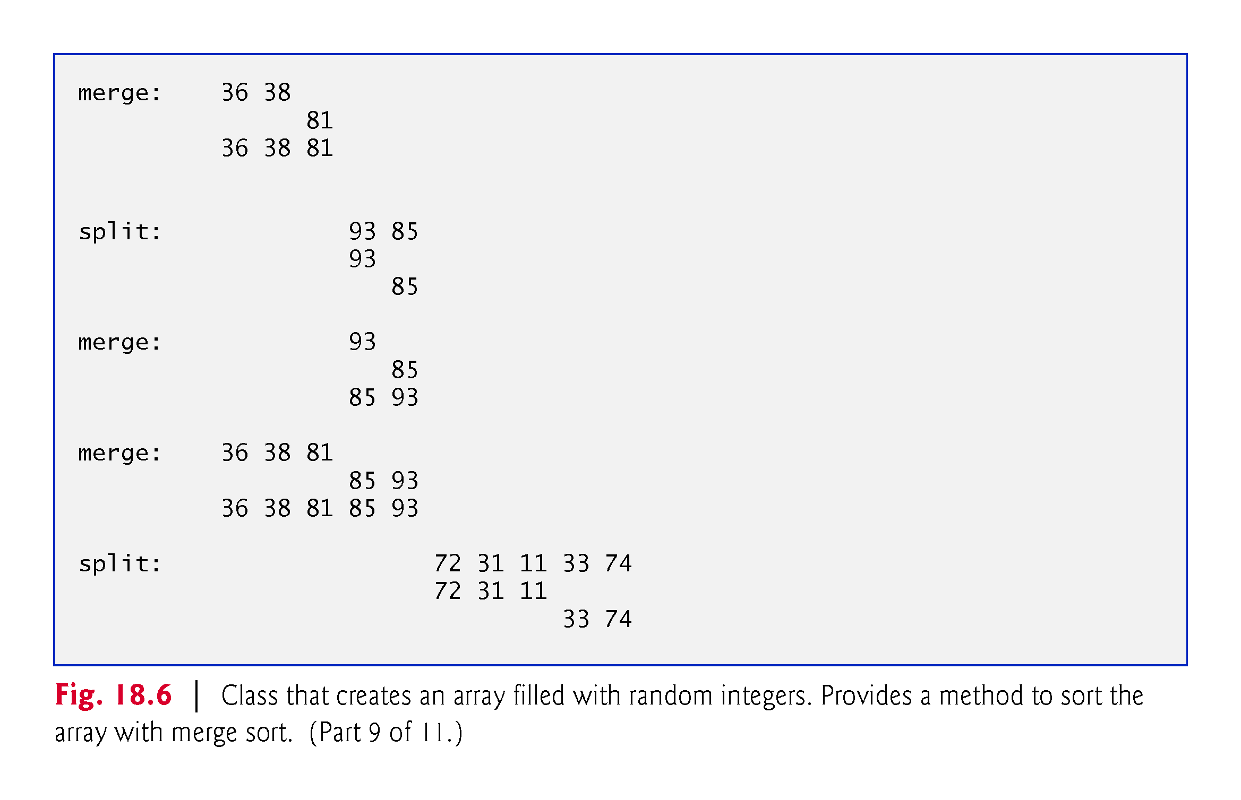

Slide 84
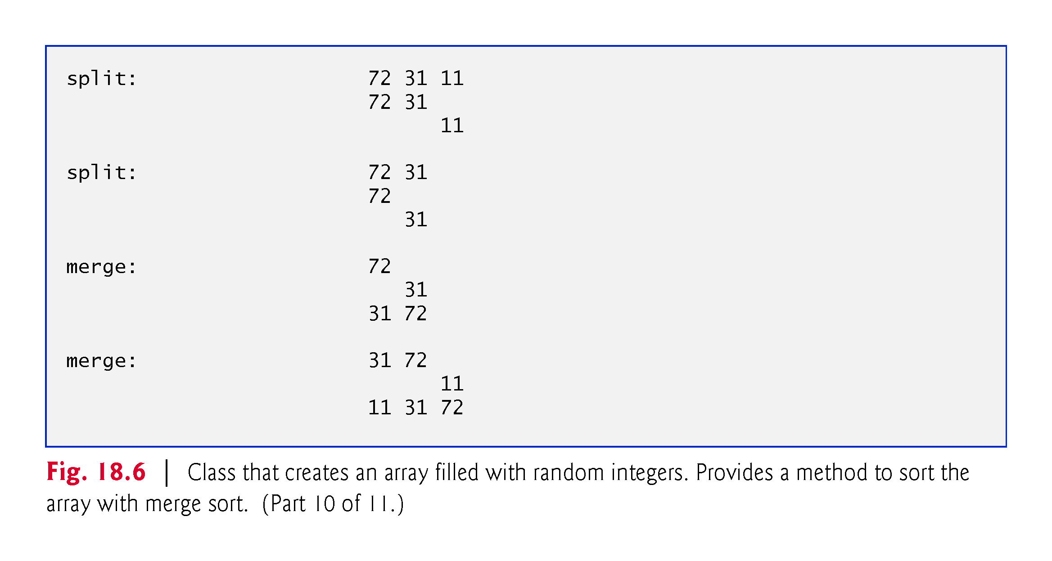

Slide 85
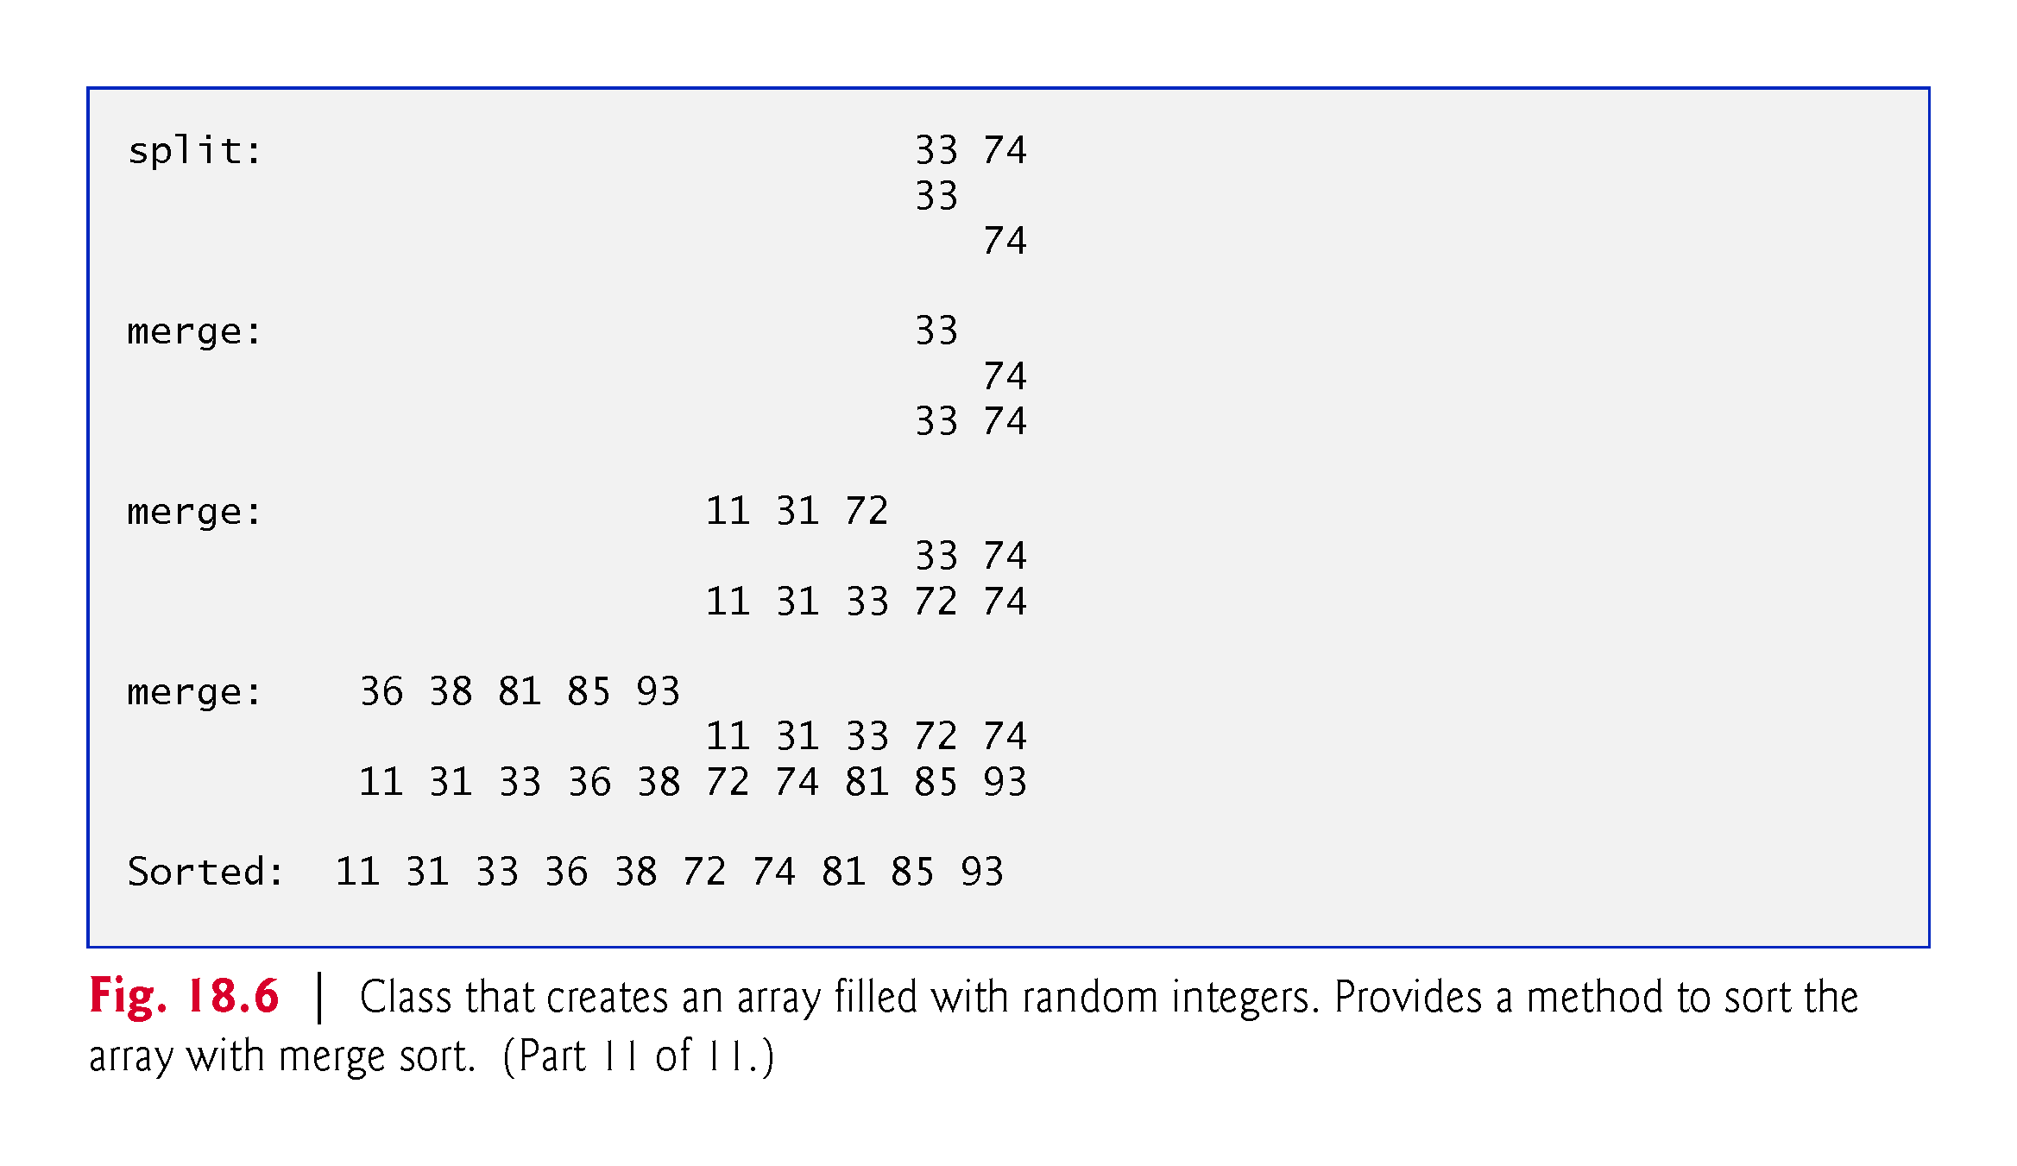

Slide 86
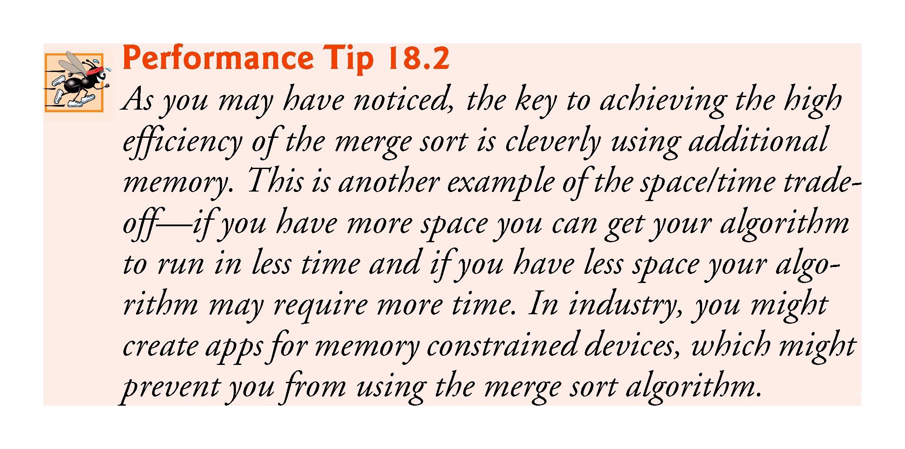

Slide 87
18.4 Summary of the Efficiency of Searching and Sorting Algorithms
Figure 18.12 summarizes many of the searching and sorting algorithms covered in this book and lists the Big O of each.
Figure 18.13 lists the Big O expressions covered in this chapter, along with a number of values for n to highlight the differences in the growth rates.

Slide 88
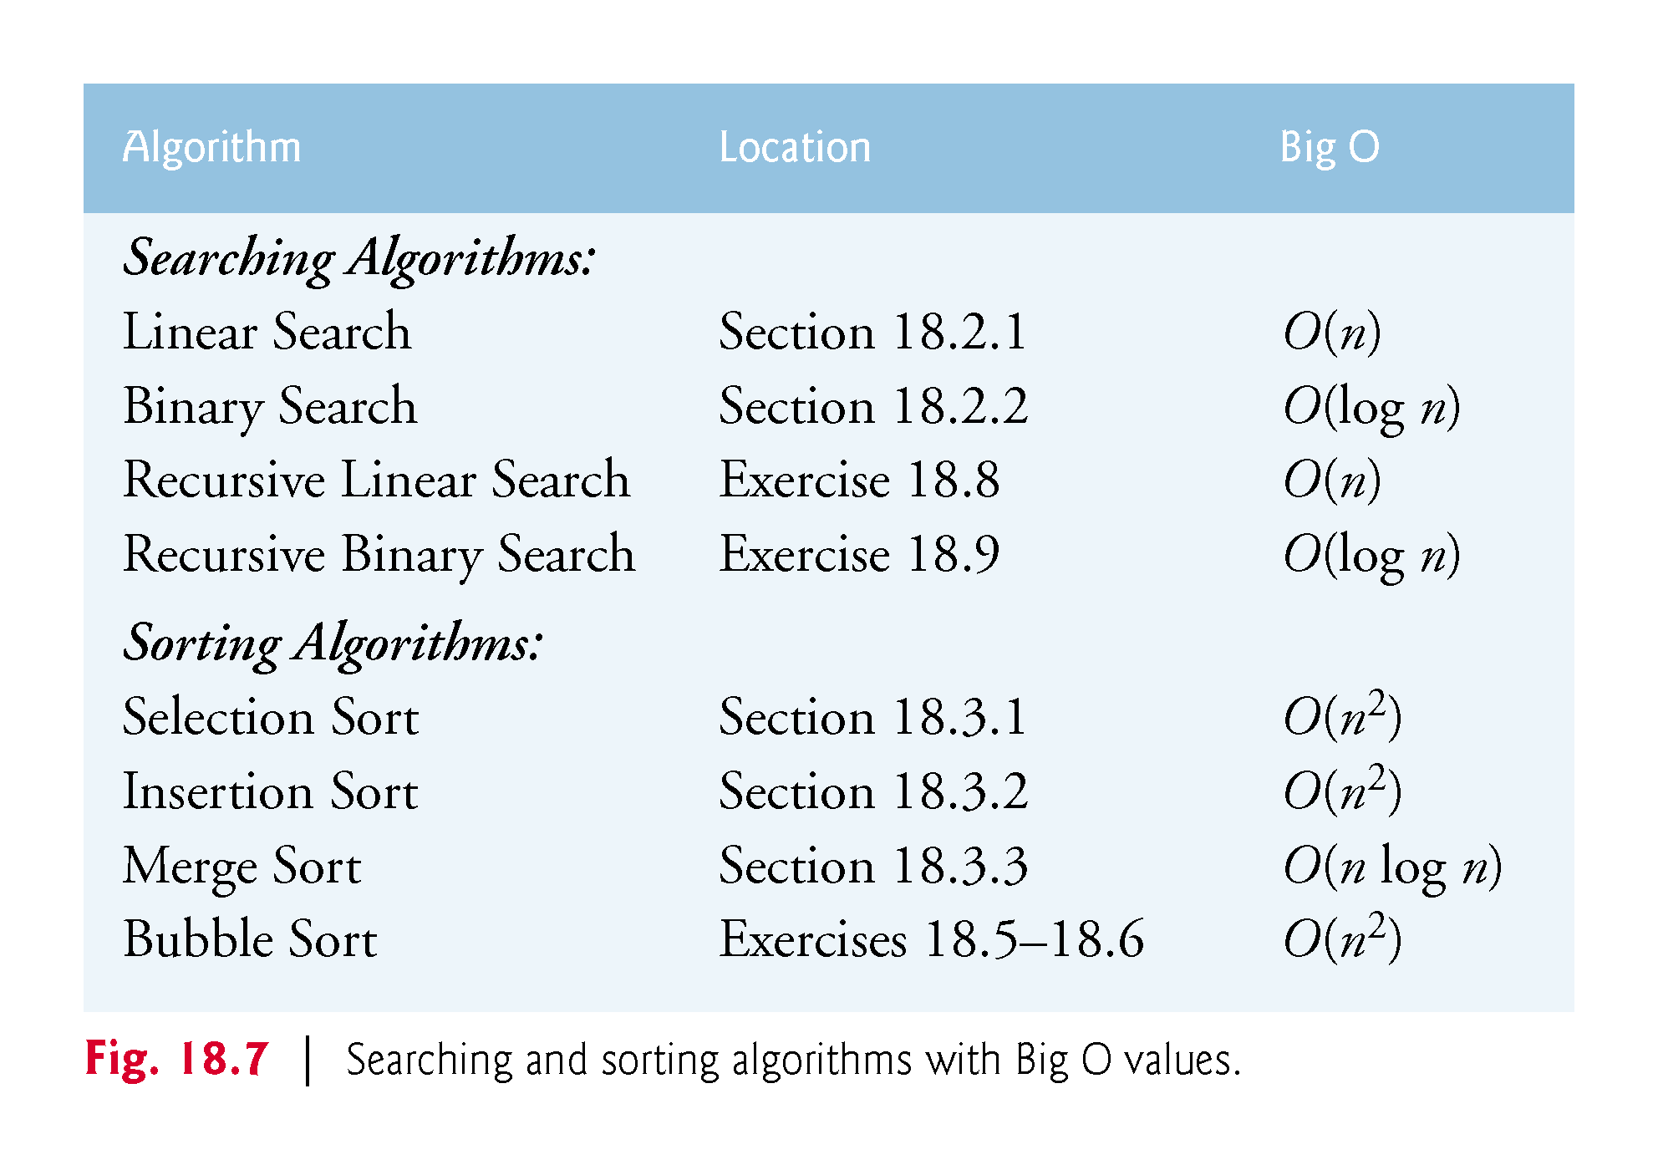

Slide 89
